Slide 1
Tobacco Dependence
Knowledge and Skills for Effective Tobacco Interventions

Slide 2
Objectives
Discuss health consequences of tobacco abuse
Identify some causes for tobacco abuse
Implement strategies to increase screening for tobacco use
Understand where AAR and 5A strategies are appropriate to use for tobacco cessation efforts
Define various stages of change in relation to motivational interviewing counseling and basic action planning
Describe harmful effects of e-cigs

Slide 3
The Health Impact
Consequences of Tobacco Abuse

Slide 4
The Health Consequences of Smoking—50 Years of Progress: A Report of the Surgeon General

Slide 5
On January 11, 1964, Luther L. Terry, M.D., the 9th Surgeon General of the United States, released the first report on the health consequences of smoking: Smoking and Health: Report of the Advisory Committee of the Surgeon General of the Public Health Service

Slide 6
Impact: Cost of Smoking
Chief Preventable cause of 435,000 deaths/yr
Cost to society, individual & family is $40 per pack
If all Medicaid recipients quit annual savings to would be $9.7 billion after 5 years
Cost patients years of life, relationships and health (Women now lose about 11 years of life expectancy, men lose about 12 years)
Notes:
Women now lose about 11 years of life expectancy
Men lose about 12 years

Slide 7
Impact: Recent Findings
Smoking impacts nearly every organ
No risk-free level of exposure to secondhand smoke
Risk of diabetes is 30–40% higher for smokers
Positive dose-response relationship between the number of cigarettes smoked and the risk of developing diabetes

Slide 8
Prevalence
Demo graphic | Prevalence²
American Indian/Alaska Natives | 32.4%
African Americans | 23%
Whites | 21.9%
Hispanics | 15.2%
Asians | 10.4%
GED Diploma | 46%
Undergraduate Degree | 9.6%
Graduate Degree | 6.6%
Below Poverty | 30.6%
Above Poverty | 20.4%

Slide 9
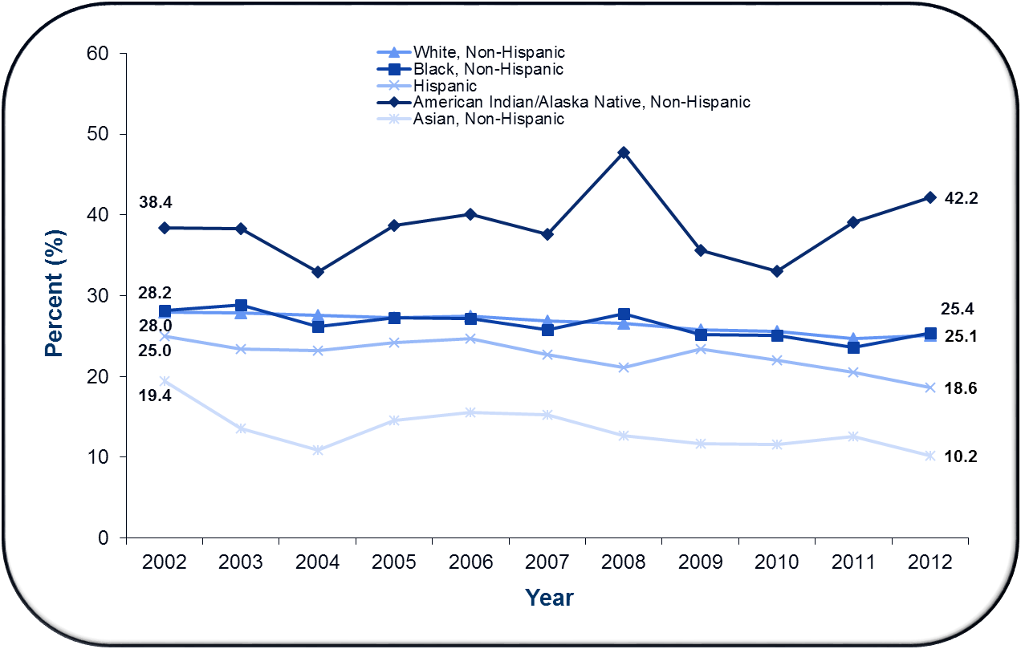
Cigarette Smoking Among Adults aged ≥18, by Race/Ethnicity – United States, 2002-2012 (American Indian/Alaska Native, Non-Hispanic = highest rate)
Source: National Survey on Drug Use and Health, 2002-2012.
Notes:
Smoking prevalence varies by race/ethnicity with American Indian/Alaska Native, Non-Hispanic having the highest rates.

Slide 10
Impact: Challenge Remains
Economic costs > $289 billion annually
42 million Americans still smoke
Smoking-attributable mortality is expected to remain at high and unacceptable levels for decades to come unless urgent action is taken
The annual costs of direct medical care > $130 billion

Slide 11
Impact: Challenge Remains
E- cig use in U.S. middle and high school doubled between 2011 and 2012
Tobacco industry continues to introduce and market new products
Focus on populations with a higher prevalence of tobacco use and lower rates of quitting
5.6 million U.S. youth will die prematurely during adulthood from their smoking

Slide 12
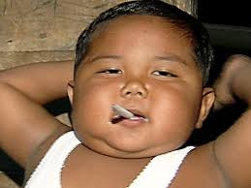
Impact: Underage Smokers
87% first use of cigarettes occurs by 18 years of age
98% first use by 26 years of age
3,200 per day smoke their first cigarette
2,100 per day become adults daily smokers
*Aldi, a 2 year old Indonesian smoker who smokes up to 20 cigs a day

Slide 13
Impact: Third Hand Smoke
Residual tobacco smoke contamination
Contains cancer-causing substances
Poses a health hazard to nonsmokers and children
Smoke clings to hair, skin, clothes, furniture, drapes, walls, bedding, carpets, dust, vehicles and surfaces
May persist in ceiling tiles for up to 30 years
Most soaps will not remove nicotine residue
Removing from carpet may be impossible

Slide 14
Tobacco Kills more Americans than AIDS, Hepatitis C, alcohol, all drug abuse deaths legal or illegal including cocaine and heroin, and suicide combined
Source American Lung Association

Slide 15
Tobacco Abuse: Causes and Contributions
Money Talks ?

Slide 16
The Tobacco Industry
Initiated & sustained by aggressive strategies
Deliberately misled the public on smoking risks
Counter campaigns with aggressive advertising
Used tactics to create doubt about the findings on smoking and health
Obscured the dangers implying that certain cigarettes were safer
$8.4 billion spent in 2011 on Marketing

Slide 17
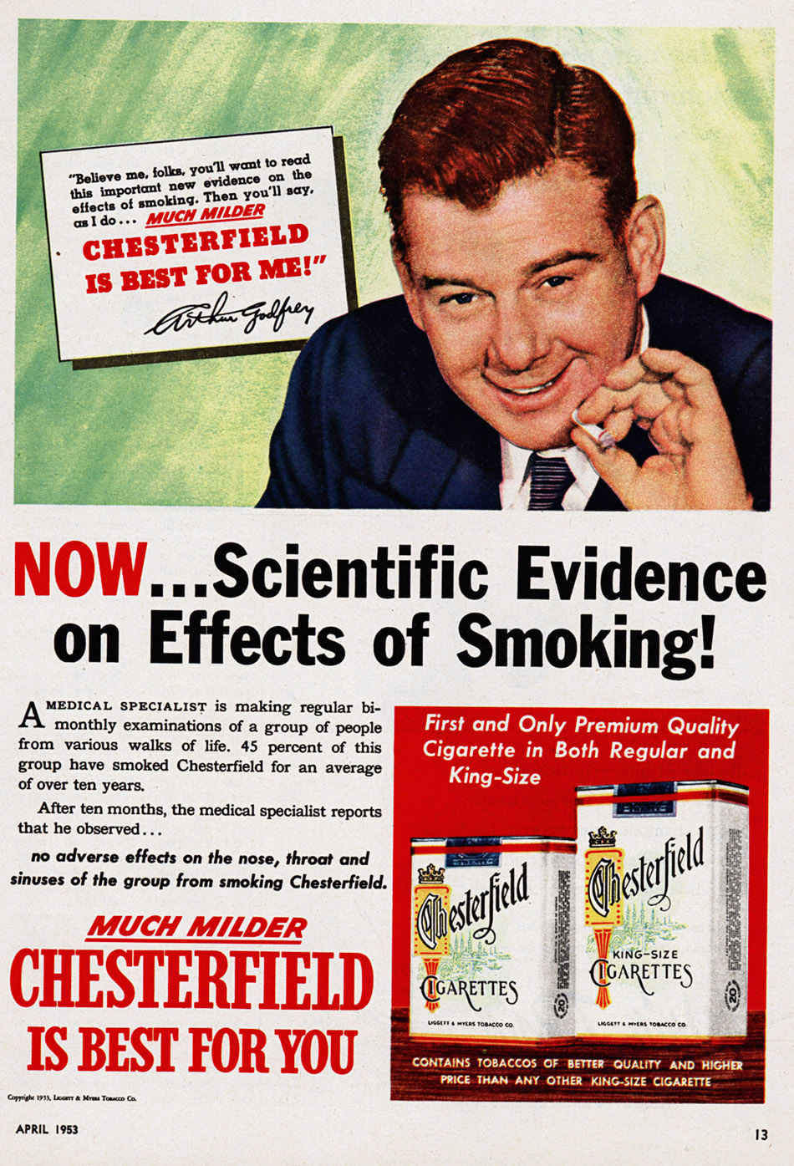

Slide 18
Tobacco Industry
Marketing to Native Americans has included advertising and promotion of cigarette brands American Spirit
Price discounts paid to retailers or wholesalers to reduce the price of cigarettes to consumers ($7 billion)
Tobacco Industry is outspending prevention efforts 18:1

Slide 19
Chromosome Y
Smokers are 2.4 to 4.3 times more likely to be missing Y chromosomes than nonsmokers
Loss of Y associated with shorter survival and higher risk of cancer
Smoking has a transient and dose-dependent mutagenic effect
Links a preventable risk factor with the most common acquired human mutation

Slide 20
Causes: A Chronic Disease
Cycle through multiple periods of remission and relapse
70 % of the 42 million report wanting to quit
44 % attempt to quit each year
most unaided and unsuccessful
4 to 7 % were successful

Slide 21
Strategies to Reduce Tobacco Abuse: Taxing Tobacco
10% increase in cigarette prices yields a 4% drop in adult cigarette consumption
Youth much less likely to start if priced high
Offset inflation and tobacco industry attempts to control prices
Single most effective component
Chaloupka FJ, Straif K, Leon ME. Effectiveness of tax and price policies in tobacco control. Tobacco Control 2011;20(3):235–8.
U.S. Department of Health and Human Services. The Health Consequences of Smoking—50 Years of Progress: A Report of the
Surgeon General. Atlanta, GA: U.S. Department of Health and Human Services, Centers for Disease Control and Prevention,
National Center for Chronic Disease Prevention and Health Promotion, Office on Smoking and Health, 2014.

Slide 22
Strategies to Reduce Tobacco Abuse: Aggressive Media Campaigns
Reduce youth initiation
Encourage cessation
Increase negative attitudes toward tobacco use
Increase support for policy change

Slide 25
Strategies To Reduce Tobacco Abuse
WHAT CAN WE DO?

Slide 26
Clinical Practice Guideline Recommendations
Provide adequate training and resources
Dedicate staff to treat tobacco dependence
Promote hospital policies that support and provide tobacco dependence services
Implement tobacco user identification system -document and query at every visit

Slide 27
Guideline- “Tobacco User Identification Process” SCREENING
Why Do We Screen for Tobacco Exposure?
To identify users and offer help and motivation
To promote healthy lifestyles
To help our patients live longer, healthier lives
To efficiently utilize our resources and time
To open up opportunities for life saving interventions for our patients

Slide 28
SCREENING: A Fast, Efficient Method: The “5 A’s”
Ask if they use tobacco
Advise to quit in a strong personalized manner-Document
Assess willingness to quit
Assist with quit plan
Arrange for follow up

Slide 29
5 A’s: ASK
Ask each patient (>5 years), at EVERY encounter
“Do you smoke tobacco products?”
“Do you chew tobacco products?”
“Do people use tobacco products in your home or work?”
If NO – Congratulate them!
If YES – DOCUMENT and proceed to 2nd step

Slide 30
SCREENING – “ASK, ADVISE..”
Screener ASKS
about current tobacco use
YES
Screener ADVISES patient to quit
Referral
•1-800-QuitNow
• CIH Smoking Cessation Clinic
• American Lung Cherokee Nation
• PCP
NO
Congratulate & encourage continued abstinence
Patient wants to set Quit Date within 14 days
Patient does not want to set Quit Date within 14 days
Encourage patient to consider quitting tobacco

Slide 31
Patient NOT Willing to Quit: Think “5R’s”
Consider Briefly Discussing Relevance -
Rewards – benefits that apply to that patients (improved lung function, better overall health, decreased MI risk)
Risks – “what will happen if you continue to smoke?”
Roadblocks – “what’s preventing you from quitting?”
Repetition – Ask them if you can ask about smoking cessation next time. And do so at EVERY encounter.

Slide 32
5 A’s: ADVISE
Advise all current tobacco users to quit using tobacco in a clear, strong, & personalized manner
Encourage patients by giving advice relevant to each patient’s health/lifestyle concerns
DOCUMENT your advice “to quit”
Wellness (education) Tab
Patients encouraged to quit by a clinician have been found to be almost twice as likely to quit

Slide 33
5 A’s: Advise, continued
Remember to use personal motivational factors
Cost
Damage to skin, hair, looks
Smell (hair, breath, clothes)
Health complications
Health of family members

Slide 34
5 A’s: ASSESS
Assess patients’ willingness to set a Quit Date within 14 days
“Are you willing to start a quit plan/set a quit date?”
There are several Stages of Change (willingness to quit) - we are interested in three in particular

Slide 35
ASSESS: Stages of Change
Precontemplation | Contemplation | Preparation
Not ready to quit | Thinking about quitting | Ready to quit
No intent to set quit date within 6 months | Intent to set quit date within 6 months | Set quit date within 30 days

Slide 36
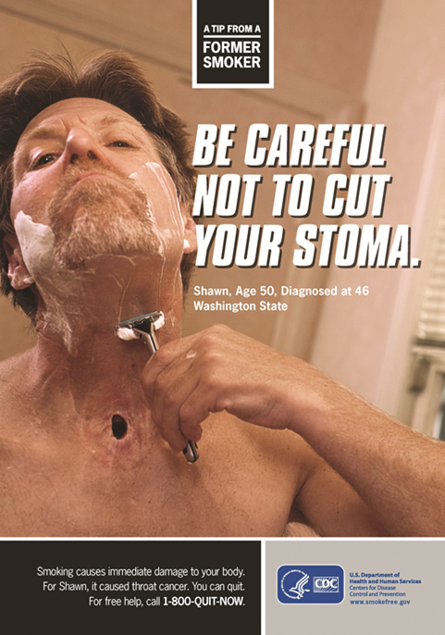
5 A’s: ASSIST
For the patient unwilling to set a quit date
Utilize motivational interviewing techniques
Brief Motivational Interview
Relevance
Rewards
Risks
Roadblocks
Repetition

Slide 37
5 A’s: ASSIST
Not willing to quit:
Relevance
Rewards – benefits that apply to that patients (improved lung function, better overall health, decreased MI risk)
Risks – “what will happen if you continue to smoke?”
Roadblocks – “what’s preventing you from quitting?”
Repetition – Ask them if you can ask about smoking cessation next time. And do so at EVERY encounter.

Slide 38
5 A’s: Assist, Arrange
For the patient willing to set a Quit Date, assist the patient in making a Quit Plan
Provide resources and educational materials
Set quit date, treatment plan
Arrange: Make referrals to intensive programs

Slide 39
Guideline Recommendation- “Provide Adequate Training and Resources”
Knowledgeable Providers
Knowledgeable Patients
Skilled in Counseling and Brief Action Planning

Slide 40
Knowledge Is Power
Do you know: Tobacco Abuse PREVALENCE?
Can you relay: Health Consequences Information?
Can you discuss: Causes/contributions to tobacco abuse in our society?
Do you know harmful effects from e-cigs?
Can you discuss the stages of change (readiness to quit) and what motivational interviewing techniques are appropriate for each stage?
Are you comfortable assisting with Quit Plans?

Slide 41
Causes: Chain of Addiction
3 Chain Link of Addiction Model
Biological
Psychological
Sociocultural

Slide 42
Chain of Addiction
Example:
Heroin Addicted Vietnam Vets
15 % U.S. servicemen in Vietnam were addicts
Only 5 % relapsed to heroin use in the 1st year
Compared to 90% relapse rates in US
45 % of what people do every day is in the same environment and is repeated
Outsourcing the control of the behavior to environment

Slide 43
Knowledgeable Providers
Pharmacists Role
Counseling
Brief intervention
Motivational Interviewing
Development of individualized quit plans
Pharmacotherapy selection, adjustment, monitoring, and follow up
Clinic Development

Slide 44
Knowledgeable Providers- Then Why Aren’t We Assisting?
Pharmacist (Lack of) Involvement
71% of pharmacists cite importance in assisting patients with quitting
45% of pharmacists were interested in providing services
Only 5–7% of patients report that a pharmacist has ever inquired about their tobacco use
Pharmacists report low levels of participation in tobacco-cessation activities

Slide 45
Pharmacist Perceived Barriers
Fear of offending or alienating patients
Lack of time
Smokers who receive counseling about importance of smoking cessation have improved satisfaction with their health care
May not only improve the life of your patient but may also enhance patient loyalty
Be confident and ask about tobacco status

Slide 46
But Look At What Patients Think About Pharmacists
Availability of information and resources was viewed positively
Accepting of pharmacist tobacco cessation interventions
Felt it was the duty of the pharmacist to ask, advise, & offer tobacco cessation counseling
85 % agreed pharmacies were the most convenient places for tobacco cessation programs

Slide 47
Stages of Change and MI
Stage 1: Not Ready to Quit
DO
Strongly advise to quit
Provide information
Ask noninvasive questions;
identify reasons for tobacco use
Raise awareness of health
consequences/concerns
Demonstrate empathy, foster
communication
Leave decision up to patient

Slide 48
Stages of Change and MI
Stage 2: Ready to Quit
Ready to quit in the next month
Patients are aware of the need to, and the benefits of, making the behavioral change.
Patients are getting ready to take action.
**Discuss Key Issues, Facilitate Quitting Process
GOAL: Achieve cessation.

Slide 49
Motivational Interviewing
The Basics

Slide 50
MI Defined
The most recent definition of motivational interviewing (2009) is:
“A collaborative, person-centered form of guiding to elicit and strengthen motivation for change”
Notes:
Not just a cheerleader type of “Lets go..rah rah..”Now, since this is only a 30 minute presentation, we will get into the NEW acronym that may help you quickly assess patients’ readiness to change … remember this is only touching on the basics…this stuff really requires more training and practice…

Slide 51
Motivational Interviewing (MI)
Useful in Chronic Disease, Chronic Care Models?
Useful in Health Promotion/Disease Prevention?
YES!
Evidence based standards guide self managed care with resulting improved outcomes.
Notes:
In short presentation, don’t have time for too many details, since this MI technique over a two day workshop wasn’t even enough time, so we will get right into the use of the MI tools, followed by examples that may be useful in practice. Remembering these acronyms may help: READS, FIRE,

Slide 52
Motivational Interviewing TOOLS
“READS”
Roll with Resistance
Empathy (rephrase, repeat what patient said)
Avoid arguing
Develop Discrepancy (“one one hand…on the other hand…” What is said vs what is being done.)
Support Self Efficacy

Slide 53
Tool Kit: “R”
Roll with resistance
Example – “You are not ready to quit smoking at this time.”
When to use ?
When patients are expressing issue resistance

Slide 54
Tool Kit: “E”
Express empathy
Example – “You are worried that you may not be able to quit without your husband quitting.”
When to use?
To demonstrate understanding and to address a patient’s core concern
(Active Listening, Safe environment, Support, Information, Rephrase with “feeling”)

Slide 55
Tool Kit: “A”
Avoid Argumentation
Example – “You do not see yourself quitting smoking at this time. What types of things are you willing to do to get your cholesterol down?”
When to use?
To demonstrate understanding and to prevent creating relational resistance
Notes:
If time, we could give lots of funny or disturbing “real life” examples of situations where hcp did NOT avoid argumentation… ☺

Slide 56
Tool Kit: “D”
Develop Discrepancy
Example – “On the one hand, you have an important goal of lowering your blood pressure to prevent stroke and heart attack. On the other hand, your smoking raises your blood pressure and your risks. What are your thoughts?”
When to use?
To create change talk and throw the patient’s system out of kilter without creating more resistance
(Identify core values of patient and if their behavior is consistent with those values)
Notes:
Picture “double Ds” – “on the one hand, on the other hand”……

Slide 57
Tool Kit: “S”
Support Self-efficacy
Example – “I am really glad to hear that you are thinking more about quitting. What has you thinking more about that?”
When to use?
To reinforce both thoughts and actions regarding behavior change

Slide 58
CONVERSATIONAL TOOLS
“FIRE”

Slide 59
CONVERSATIONAL TOOLS
“F”= Fence: A look over the fence
Examples :
“If you were to wake up tomorrow and you were no longer a smoker, what would you like about that?”
“If you could snap your fingers and be at the weight you wanted to be at, what would you like about that? What would you see as the benefits?”
“Encourage change talk, create dissonance”
Notes:
When to use – to encourage change talk and assisting the patient in making the argument for the change—
creates dissonance (develop discrepancy)

Slide 60
CONVERSATIONAL TOOLS
“I”= The Insurance Card
“MAY I TELL YOU WHAT CONCERNS ME?”
Patient: We’ve all got to die some time. Might as well go out doing something I enjoy.
HCP: You really enjoy smoking and no one can live forever any way.
Patient: Right.
HCP: May I tell you what concerns me?
Prevent “fixing” or “saving” the patient

Slide 61
Conversational Tips
“R” = The Ruler
Assess Readiness to Change by TWO important scale questions: Importance and Confidence
Example: from a 1 to 7 or a 1 to 10 scale
How important is this change for you?
How confident are you that you can make this change if you want to?
Why did you choose a ____, not a 1?
Elicits “Change Talk”

Slide 62
CONVERSATIONAL TIPS
“E” = The Envelope
Example:
“If I were to hand you an envelope, what would the message have to say inside for you to consider quitting?”
(or whatever change you are discussing)
Explore readiness for change
Notes:
I don’t know about this one. Maybe you do. I think if I was in a mode of resistance to change, I would answer like “well I would need a GUARANTEE “. . ???

Slide 63
Easy Examples for Patient Interactions as you “ASK”
Step 1: Ask about tobacco use
“I take time to ask all of my patients about tobacco use—because it’s important.”
“Do you smoke, or does someone you know smoke?”
“Have you used tobacco, hookah, e-cigarettes, or any other types of tobacco or nicotine?”
Ask about tobacco use
Approach should be genuine and sensitive, conveying concern for the individual’s well being
Non-judgmental tone
May ask for permission to ask questions

Slide 64
Easy Examples for Patient Interactions as you “ADVISE”
Step 2: Advise tobacco users to quit
“Occasional or light smoking is still harmful.”
“I realize that quitting is difficult. It is the most important thing you can do to protect your health now and in the future. I have training to help my patients quit, and when you are ready, I will work with you to design a specialized treatment plan.”
Message should be clear, strong and personalized
Clear -quit completely
Strong -most important way to protect one’s health
Personalized - tied into the unique situation of the individual
Message delivered without judgement
Tone and manner should convey a concern for individual’s well- being

Slide 65
Steps 3 and 4: ASSESS and ASSIST
Stage 1: Unwilling to quit
Assess:
• Not ready to quit in the next month, or not thinking about it, or thinking about it but not ready.
• Do not assume that patients who inquire about quitting are ready to quit
Assist: Goal – start thinking about quitting
“Do you ever plan to quit?”
“May I tell you why your smoking concerns me?”
“I can tell you some of the benefits of quitting now rather than later.”
• Tailored motivational message with 5R’s
• Stress the importance of quitting for patient’s health
• Ask patient not to rule out possibility of quitting
• Offer to assist patient with quitting if he/she changes his/her mind
• Leave decision up to patient

Slide 66
Steps 3 and 4: ASSESS and ASSIST
Stage 2: Willing to Quit within the next MONTH
Assist: Goal – achieve cessation
“What type(s) of tobacco do you use and how much?”
“What are your most important concerns about quitting?”
“How have you tried to quit smoking previously?”
Assess tobacco use history:
type, amount, duration, recent changes, past quit attempts
Discuss key issues: motivation, confidence, triggers for use, routines, etc
Facilitate quitting process: method, quit date, tobacco use log, coping strategies
Design a treatment plan:
medication counseling

Slide 67
Suggested Readings
Berger, BA, APhA. Communication Skills for Pharmacists. Washington, DC, 3rd edition.
Definition of Motivational Interviewing.
www.motivationalinterview.org
Rollnick, S, Miller, WR, Butler, CC. Motivational Interviewing in Health Care. The Guilford Press, New York. 2008.
Rollnick, S, Mason, P, and Butler, C. Health Behavior Change. Churchill Livingstone, London. 2000.

Slide 68
Electronic Cigarettes (e-Cigarettes)
Notes:
FDA

Slide 69
The Product
Manufactured mainly in China
Variability in engineering, nicotine concentrations, and volumes of solution
Different carrier compounds
(most commonly propylene glycol with or without glycerol [glycerin])
Propylene glycol makes up about 90% of the solution
Variety of additives and flavors
Variance of battery voltages

Slide 70
Marketing
$15 million on TV ads the first nine months of 2013, up from $1.1 million during the same period the year before
Younger generations have never experienced such marketing of an addictive product

Slide 71
Marketing
64% of sites made cessation related claims (direct and indirect statements)
Produce only “harmless water vapor”
Tobacco companies unable to market on television and radio since the 1970s
Marketing directed at the young adults and children according to FDA documents

Slide 72
Marketing
Heavily influence consumer perceptions
Marketing claims
healthier (95%), cheaper (93%), and cleaner (95%) than cigarettes; can be smoked anywhere (88%); can be used to circumvent smoke-free policies (71%); do not produce secondhand smoke (76%); and are modern (73%)
Celebrities have been used to market e-cigarettes since at least 2009

Slide 73
Prevalence in Youth
1.78 million students had tried e-cigs by the end of 2012
High school students (10.0%) vs adults (6.2%)
Dual use with conventional cigarettes is predominant 2011:
61% in US middle school
80% among US high school
Despite Utah law prohibiting e-cigarette sales to minors, youth are 3 times more likely to report
e-cigarette use than adults

Slide 74
Youth e-cigarette users who have never smoked conventional cigarettes
160,000 students who reported trying electronic cigarettes had never used combustible cigarettes
In 2012 in US
20.3% of middle students
7.2% of high students
In 2011 in Korea
15% of students in grades 7 through 12
The Utah Department of Health
32%

Slide 75
Inconsistent Nicotine Content
Solutions that were labeled 0 mg of nicotine contained nicotine
Differences between labeled and actual nicotine between 28-89%
Small quantities of cotinine, and several nicotine related impurities were detected

Slide 76
Particulate Matter
Creates an aerosol of ultrafine particles
Higher e-liquid nicotine content was associated with higher particle numbers
Longer puffing time resulted in more particles
Some e-cigarettes deliver more particles than conventional cigarettes
Ultrafine particles from tobacco smoke or air pollution contribute to pulmonary and systemic inflammatory processes increase the risk of cardiovascular and respiratory disease and death

Slide 77
Nicotine Absorption
Early studies found that e-cigarettes delivered lower levels of nicotine than cigarettes
Experienced users had nicotine absorption similar to that with conventional cigarettes
Delivery is highly dependent on a number of factors, including vaping technique, particle evolution, and cloud effect

Slide 78
Nicotine Absorption
Modifications leading to arterial delivery could dramatically increase the risk of addiction and abuse, and overdose
Philip Morris and British American Tobacco purchased nicotine-inhaler technologies that promise pulmonary delivery

Slide 79
Potential for Cytotoxicity
Cytotoxic to human embryonic & mouse neural stem cells
Refill fluids may have cytotoxic prenatal effects
Raises concerns about pregnant women who use e-cigarettes or are exposed to secondhand aerosol

Slide 80
Fires and Explosions
25 incidents in the U.S. dating from 2009 to August 2014
20 incidents occurred while charging
2 occurred during use
2 unclear if in use, idle or being charged
1 during transportation on a cargo aircraft

Slide 81
Injuries from Fire/Explosion
10 injuries and 0 deaths were reported
Several burn injuries reported
2 serious injuries occurred when devices exploded in users’ mouths
A case reported explosion knocked out teeth, part of tongue, and set fire to room
1 death was reported in UK incident when device exploded and ignited nearby oxygen equipment

Slide 82
Exposure to Heavy Metals in Aerosol
Presence of toxic metals (lead, cadmium, nickel, nickel & chromium nanoparticles) and silicates
2 to 100 times higher than found in cigarettes
Nanoparticles can potentially cause respiratory toxicity and enter the bloodstream

Slide 83
Health Effects of Propylene Glycol
Repeated inhalation may affect the central nervous system, behavior, and the spleen
May increase the risk of acquiring asthma
Dow Chemical Company states - “inhalation exposure to mists should be avoided”
American Chemistry Council warns against its use in theater fogs because of eye and respiratory irritation
May form propylene oxide, a carcinogen, and acrolein, a respiratory tract irritant
Notes:
an International Agency for Research on Cancer class 2B carcinogen

Slide 84
Diethylene Glycol
Known carcinogen & ingredient in anti-freeze, was detected in a cartridge analyzed by the FDA
May reflect the use of non-pharmaceutical grade propylene glycol
History of mass poisonings and deaths when inadvertently substituted for propylene glycol in consumer products

Slide 85
Secondhand Exposure
A study measuring indoor pollution found elevated nicotine, glycerin, aluminum,7 polycyclic aromatic hydrocarbons classified as probable carcinogens
A Chamber study compared emissions of conventional cigarettes and e-cigarettes found serum cotinine in nonsmokers was similar for cigarette smoke and e-cigarette aerosol exposure
Notes:
Possible carcinogens per the International Agency for Research on Cancer

Slide 86
FDA Adverse Event Reports for E-Cigarettes
The ADRs have included hospitalization for illnesses such as:
pneumonia
congestive heart failure
disorientation
seizure
hypotension

Slide 87
Active Medications in Solutions
FDA issued warnings to several e-cigarette companies for selling e-cartridges and refill solutions containing active pharmaceutical ingredients
rimonabant (Zimulti®) for the purpose of losing weight and reducing smoking addiction
tadalafil (Cialis®) for increasing sexual capacity

Slide 88
Nicotine Poisoning
5-ml vial of e-cigarette refill solution could contain a nicotine concentration of 20 mg/ml or 100 mg/vial
Known lethal dose of nicotine
10 mg in children and between 30 and 60 mg in adults

Slide 89
Smoking Cessation
International Tobacco Control study in the US, Canada, UK, and Australia found e-cigarette users were no more likely to have quit 1 year later than nonusers
In a quitline survey, e-cigarettes users were statistically significantly less likely to quit than those who had not used e-cigarettes
A cross-sectional survey of 1,836 found that electronic cigarettes were not associated with successful quit attempts

Slide 90
Elements of a Quit Plan

Slide 91
Quit Date
Day to begin total abstinence
Meaningful and easily remembered
Pick a day when patient will be busy but not highly stressed
Setting a quit date increases quit rate by 50%

Slide 92
Support
Friends, family, work place, social group, Smoking Cessation clinic, help lines
Talking with support person nearly doubles chances of cessation
Social support increased quit rates 45% in studies

Slide 93
Techniques & Tips for Quitting
Recognize and deal with triggers & have a plan of action
Developing coping skills to handle triggers
Taking deep breaths, relaxing techniques, hobbies, delay tactics
Techniques to prepare before quitting and prevent relapse increase quit rates 45%

Slide 94
Pharmacotherapy
1st line treatment agents
Nicotine Replacement
Zyban® bupropion
Chantix ® varenicline
Doubles or triples chances that a person will successfully quit tobacco

Slide 95
Conclusions
Although much progress has been achieved since the Surgeon General’s report in 1964, tobacco remains a major health problem
Screening and offering brief interventions are effective in promoting tobacco cessation
Native Americans are disproportionally affected by tobacco having the highest prevalence of any ethnic group

Slide 96
Conclusions
Per 2008 PHS Guidelines clinicians should encourage all patients attempting to quit to use effective medications for tobacco dependence treatment, except where contraindicated or for specific populations for which there is insufficient evidence of effectiveness (i.e., pregnant women, smokeless tobacco users, light smokers, and adolescents)
Smoking is a not merely a habit but a chronic disease
If the status quo remains, millions will die prematurely secondary to tobacco use

Slide 97
Conclusions
Smokers and e-cigarette users have FDA approved cessation options
E-cigarette emissions are not “harmless water vapor”
Adverse health effects for non-smokers exposed to the emissions of electronic cigarettes cannot be excluded

Slide 98
Special Thanks
LCDR Jessica Steinhert, PharmD
Joshua Tennison , Pharm.D candidate
LCDR Rebecca Geiger, PharmD
LCDR John Collins, PharmD
LCDR John Bousom, PharmD
LT Julie Niewoehner, PharmD
CAPT Lisa Becker, DPh
CDR Narcisso Soliz, PharmD

Slide 99
Sources
U.S. Department of Health and Human Services. The Health Consequences of Smoking—50 Years of Progress: A Report of the Surgeon General. Atlanta, GA: U.S. Department of Health and Human Services, Centers for Disease Control and Prevention, National Center for Chronic Disease Prevention and Health Promotion, Office on Smoking and Health, 2014.
Dent, L.A. Pharmacist Delivered Tobacco Cessation. Pharmat. Volume 34, number1. March 2011.
Fiore, C., Jaen, C. R., & Baker, T. B. (2008). Treating tobacco use and dependence: 2008 update. Rockville, MD: U.S. Department of Health and Human Services, Public Health Service
Centers for Disease Control and Prevention. Best Practices for Comprehensive Tobacco Control Programs — 2014.Atlanta: U.S. Department of Health and Human Services, Centers for Disease Control and Prevention, National Center for Chronic Disease Prevention and Health Promotion, Office on Smoking and Health, 2014
CDC. Fast Facts.

Slide 100
Sources
Pharmacist’s Letter. Clearing the Air: How to Help Patients Quit Smoking.
Fu SS, Partin MR, Snyder A, et al. Promoting repeat tobacco dependence treatment: are relapsed smokers interested? Am J Manag Care. 2006; 12:235-243.
Hughes, J, et al. “Shape of the relapse curve and long-term abstinence rates among untreated smokers,” Addiction,99, 29-38, 2004
Forsberg, L, et al. “Mosaic loss of chromosome Y in peripheral blood is associated with shorter survival and higher risk of Cancer” Nature Genetics. 46, 624-628 (2014)
Lowell, D. What is thirdhand smoke, and why is it a concern? Mayo Clinic. http://www.mayoclinic.org/healthy-living/adult-health/expert-answers/third-hand-smoke/faq-20057791
Ware, G, Kushner, Sunavana, R, Mehrota, N, Harman,S. Electronic cigarettes and thirdhand tobacco smoke: two emerging health care challenges for the primary care provider. Int J Gen Med. 2011; 4: 115–120.

Slide 101
Sources
Lindsay McCauley, DO ; Catherine Markin , MD, FCCP ; and Danielle Hosmer , MD. An Unexpected Consequence of Electronic Cigarette Use. CHEST 2012; 141( 4 ): 1110 – 1113
Dominic L. Palazzolo Electronic cigarettes and vaping: a new challenge in clinical medicine and public health. A literature review Frontiers in Public Health. Public Health Education and Promotion November 2013 Volume 1 Article 56
George J. ,and Elias, S. Nicotine Poisoning in an Infant n engl j med 370;23 nejm.org june 5, 2014
U.S. Fire Administration (USFA). FEMA. Electronic Cigarette Fires and Explosions October2014 https://www.usfa.fema.gov/downloads/pdf/publications/electronic_cigarettes.pdf

Slide 102
Sources
Larzelerel,M., and Willams, D. “Promoting Smoking Cessation” Am Fam Physician. 2012;85(6):591-598
US Food and Drug Administration. Electronic Cigarettes (e-Cigarettes)http://www.fda.gov/NewsEvents/PublicHealthFocus/ucm172906.htm
Hudmon, K. The pharmacist’s role in tobacco cessation: Overview and introduction to the series. Am J Health-Syst Pharm. 2007; 64:1434-6
Dumanski, J, et al. “Smoking is Associated with Mosaic Loss of Chromosome Y” Science. Vol 347 no 6217 p 81-83. January 2015
Spiegel, A. What Vietnam Taught Us About Breaking Bad Habits. NPR. January 2012 available: http://www.npr.org/blogs/health/2012/01/02/144431794/what-vietnam-taught-us-about-breaking-bad-habits
Rachel Grana, PhD, MPH; Neal Benowitz, MD; Stanton A. Glantz, PhD .Contemporary Reviews in Cardiovascular Medicine E-Cigarettes A Scientific Review. Circulation. 2014;129:1972-1986

Slide 103
Sources
Vardavas, C., Anagnostopoulos, N; Kougias, M; Evangelopoulou,V. et al.. Short-term Pulmonary Effects of Using an Electronic Cigarette : Impact on Respiratory Flow Resistance, Impedance, and Exhaled Nitric Oxide. Short-term Pulmonary Effects of Using an Electronic Cigarette : Impact on Respiratory Flow Resistance, Impedance, and Exhaled Nitric Oxide. CHEST / 141 / 6 / JUNE, 2012.1401-1405
The University of Arizona Healthcare for Partnership. Basic Tobacco Intervention Skills for Native Communities. 2011.
Gray, E. The Super Bowl Ad You Won’t See this Year. Time. Companies and Industry. January 23, 2014. Available. http://business.time.com/2014/01/23/the-superbowl-ad-you-wont-see-this-year/
Nathan K. Cobb, M.D., and David B. Abrams, Ph.D. E-Cigarette or Drug-Delivery Device? Regulating Novel Nicotine Products .n engl j med 365;3 nejm.org july 21, 2011

Slide 104
Sources
Fairchild, A, Bayer,R., Colgrove, J. The Renormalization of Smoking? E-Cigarettesand the Tobacco “Endgame” n engl j med 370;4 nejm.org January 23, 2014
Schraufnagel, D, Blasi,,F, Drummond, B, Lam,D. Electronic Cigarettes: A position statement of the Forum of International Respiratory Societies. American Thoracic Society. 2014
Conley, M. Man suffers Severe Injuries After E-cigg explodes in His Mouth. ABCNews. 2/15/12. available http://abcnews.go.com/Health/electric-cigarette-explodes-fla-mans-face/story
Crusty Alexander; UCSD Assistant Clinical Professor of Medicine and staff physician at VA San Diego
James Pankow, Professor of chemistry, civil and environmental engineering at Portland State University in a letter published January 22, 2015 in NEJM)
Dewalt, E, and Soliz, N. Tobacco Triage-Screener Inservice CIH. 2014

Slide 105
Sources
Alternative Smoking Cessation Aids: A Meta-analysis of Randomized Controlled Trials. Tahiri, et al. The American Journal of Medicine. Published online: 13APR 2012
Acupuncture and related interventions for smoking cessation. White, et al. The Cochrane Library. Published Online: 23 JAN 2014
U.S. Department of Health and Human Services. Treating Tobacco Use and Dependence: 2008 Update. May 2008
Food and Drug Administration. FDA Drug Safety Communication: Safety review update of Chantix (varenicline) and risk of cardiovascular adverse events available:http://www.fda.gov/Drugs/DrugSafety/ucm330367.htm accessed March 6, 2015
Food and Drug Aministration.FDA Drug Safety Communication: Chantix (varenicline) may increase the risk of certain cardiovascular adverse events in patients with cardiovascular disease 2011. http://www.fda.gov/Drugs/DrugSafety/ucm259161.htm#professionals

Slide 106
Sources
Federal Transit Administration. Chantix ® Use Poses Safety Risk for Transportation Professionals. FTA Drug and Alcohol Regulation Updates. Winter 2012. Issue 47 http://www.fta.dot.gov/documents/da_newsletters/Issue47.pdf
Irving J, Phil M, Clark E, et al. Evaluation of a Portable Measure of Expired-Air Carbon Monoxide. Prev. Med. 1988; 17: 109-115.
Breath Carbon Monoxide Monitor – the Stethoscope of Smoking Cessation. Covita, LLC, NJ. 2010.
Benowitz N, Bernert J, Caraballo R, et al. Optimal Serum Cotinine Levels for Distinguishing Cigarette Smokers and Nonsmokers Within Different Racial/Ethnic Groups in the United States Between 1999 and 2004. Am J Epidemiol. 2008; 169:2:236-248.
Centers for Disease Control and Prevention. Biomonitoring Summary: Cotinine. 2013 Dec 04. www.cdc.gov/biomonitoring/Cotinine_BiomonitoringSummary.html (accessed 2015 Mar 5).
Jacob P, Hatsukami D, Severson H, et al. Anabasine and Anatabine as Biomarkers for Tobacco Use during Nicotine Replacement Therapy. Cancer Epidemiol Biomarkers Prev. 2002; 11: 1668-1673.

Slide 107
Sources
Chock, A, Stading J, Sexson E. Food and Lifestyle Interactions with Warfarin: A Review. US Pharm. 2009; 34(2) 28-39.
Chest Guidelines 8th Edition. Pharmacology and Management of Vitamin K Antagonists. 2008; 160s-167s.
Dipiro J, Talbert R, Yee G. Pharmacotherapy: A Pathophysiologic Approach. 2005; 389-395.
Hu Z, Yang X, Ho P, et al. Herb-Drug Interactions. Drugs. 2005; 65(9): 1239-1282.
QAS. QAS Vitamin K Registry. Available www.PTINR.com
Yu D, Davis G, Lewis D. General Principles of Warfarin Interactions in Orthopedic Patients. Pharmacology Update. October 2008 31(10): 1011-1013.
Witkowski, A, Drug Interactions Updates: Drugs, Herbs, and Oral anticoagulation. Journal of Thrombosis and Thrombolysis. 12(1), 57-71, 2001.
Lexicomp. Drug monographs
University of Arizona Healthcare Partnership. Basic Tobacco Intervention Skills

