Slide 1
Keeping UP on Diabetic Medications and Complications
Kailee fretland, pharmd, bcps, ncps
Commander USPHS
Clinical pharmacist
Red lake service unit
Red lake, Minnesota

Slide 2
Objectives
Apply current clinical practice standards to optimize pharmacologic treatment outcomes and non-pharmacological management strategies for an adult patient with type 2 diabetes.
Recognize patient situations where the utilization of a new or novel pharmacological agent appropriately optimizes type 2 diabetes management.
Apply current standards of medical care to perform appropriate patient assessments, and suggest appropriate monitoring parameters and goals of therapy or an adult patient with type 2 diabetes

Slide 3
Type 2 Diabetes
Results primarily from insulin resistance in muscle and liver, which could lead to defect in pancreatic insulin secretion
Accounts for 90-95% of diabetes
Prevalence in the US is 7.8% (about 23.6 million and growing)
Formerly known as non-insulin-dependent diabetes (adult-onset diabetes)
Often asymptomatic with a slow onset over 5-10 years
Disturbing increased trends in children and adolescents due to rise in obesity
CDC. National Diabetes Statistics Report 2014: Estimates of diabetes and its burden in the United States, 2014. Atlanta, GA: U.S. Department of Health and Human Services, Centers for Disease Control and Prevention, 2011. Available at http://www.cdc.gov/diabetes/data/statistics/2014StatisticsReport.html
CDC 2014. Summary Health Statistics for U.S. Adults: 2012. Table 8. Available at http://minorityhealth.hhs.gov/omh/browse.aspx?lvl=4&lvlID=33

Slide 4
FAST FACTS ON DIABETES
Diabetes affects 29 million people— 9.3% of the U.S. population
DIAGNOSED
21.0 million people
UNDIAGNOSED
8.1 million people
American Indian/Native American 17.9%
Non-Hispanic White 7.3%
CDC. National Diabetes Statistics Report 2014: Estimates of diabetes and its burden in the United States, 2014. Atlanta, GA: U.S. Department of Health and Human Services, Centers for Disease Control and Prevention, 2011. Available at http://www.cdc.gov/diabetes/data/statistics/2014StatisticsReport.html
CDC 2014. Summary Health Statistics for U.S. Adults: 2012. Table 8. Available at http://minorityhealth.hhs.gov/omh/browse.aspx?lvl=4&lvlID=33

Slide 5
ADA Data-Native Americans
http://www.diabetes.org/diabetes-basics/statistics/
http://www.diabetes.org/diabetes-basics/statistics/

Slide 6
Every 24 hours…
4557 adults are diagnosed with diabetes.
136 people begin treatment for end-stage renal disease.
200 nontraumatic lower-limb amputations are performed.
641 people die from diabetes, or diabetes is a contributing cause of their death.
CDC. National Diabetes Statistics Report 2014: Estimates of diabetes and its burden in the United States, 2014. Atlanta, GA: U.S. Department of Health and Human Services, Centers for Disease Control and Prevention, 2011. Available at http://www.cdc.gov/diabetes/pubs/statsreport14.html
.

Slide 7
Guidelines
Measure | ADA 2016 | ACCE 2016
HgA1c Target | <7% <8% - Elderly, frail, brittle | <6.5% >6.5% - Concurrent serious illness and high hypoglycemic risk
Monotherapy | A1c <9%: Metformin | A1c <7.5%: Met, SGLT2i, DPP4i, or GLP-1 RA
Dual Therapy | A1c >9%: Dual Therapy – Metformin + SU, TZD, DPP-4i, SGLT2i, GLP-1 RA, Insulin A1c >10% and symptomatic: Metformin +Basal + Prandial Insulin | A1c >7.5%: Dual Therapy – Metformin + (Preferred: DPP-4i, SGLT2i, GLP-1 RA, Colesevelam, Bromocriptine, Agi, Use caution: SU/GLN, TZD, Insulin)
Triple Therapy | Metformin + 2 others | Metformin + 2 others
AACE/ACE Comprehensive Type 2 Diabetes Management Algorithm 2016 Published in Endocr Pract.2016;22:84-113

Slide 8
Guidelines
Measure | ADA 2016 | ACCE 2016
Insulin | A1c >10% + Symptoms : Metformin + Basal Insulin (Start 10 U/day or 0.1-0.2 U/kg/day) + Add Prandial Insulin or GLP-1 RA if goal not achieved (1 meal or Premixed) | A1c <8%: Basal TDD 0.1-0.2 U/kg A1c >8%: Basal TDD 0.2-0.3 U/kg *Add Prandial Insulin or GLP-1 RA if goal not achieved (Plus 1, 2, 3 or Bolus Regimen)
Blood Pressure | Goal <140/90 mmHg 1st line: ACEi/ARB *Add CCB or Thiazide if needed | Goal <130/80 mmHg 1st line: ACEi/ARB Dual Therapy: BP >150/90 use ACEi/ARB + CCB, BB, Thiazide
Lipids | <40 yo w/o ASCVD Risk – no statin >40 yo – Moderate/High Intensity | ATP 3 Goals
AACE/ACE Comprehensive Type 2 Diabetes Management Algorithm 2016 Published in Endocr Pract.2016;22:84-113

Slide 9
Goals of Diabetes Management
Primary goal – prevent onset of acute or chronic complications
Acute complications:
Hypoglycemia, DKA, hyperglycemic hyperosmolar nonketotic syndrome
Chronic complications:
Microvascular: Retinopathy, nephropathy, and neuropathy
Macrovascular: Cardiovascular, cerebrovascular, and peripheral vascular diseases
Glycemic therapy goals: A1C <7% and <8% (elderly)
FPG or premeal 80-130mg/dL (change in 2015 by ADA)
Peak postprandial glucose (1-2 hours after meal) <180mg/dL
ADA 2016 Clinical Practice Recommendations: http://care.diabetesjournals.org/content/39/Supplement_1

Slide 10
Goals of Diabetes Management Cont.
Blood Pressure
BP <150/90 mmHg for >60 years old; <140/90 mmHg for everyone else (change in 2015 by ADA to match with JNC8)
For younger patients consider treating to <130/80 to prevent long term complications
ASCVD
No specific LDL-C, HDL-C, or TG goal are currently recommended
Lowering LDL-C by 30%-49% in pt with diabetes 40-75 years old and by at east 50% if 10-year risk of cardiovascular event is >7.5% (ACC/AHA 2013)
ADA 2016 Clinical Practice Recommendations: http://care.diabetesjournals.org/content/39/Supplement_1

Slide 12
Pathophysiology
Insulin Deficiency- lack of secretion
Insulin Resistance
Glucagon Secretion
Increased gastric motility
Decrease GLP/GIP
Amylin
Pepitide-YY
Leptin & Ghrelin

Slide 13
UKPDS: β-Cell Function over Time
Decline to insulin deficiency ~ 12 yrs after Dx!
Insulin loss starts 10 yrs before Dx.
100
Half gone by Dx.
80
Insulin loss is part of T2 DM
β-Cell Function (% β)
60
51% residual secretion
40
28% residual insulin secretion
20
N=376
0
-10
-9
-8
-7
-6
-5
-4
-3
-2
-1
0
1
2
3
4
5
6
Years After Diagnosis
Diabetes 44: 1249-1258, 1995
10/22/02

Slide 14
Biguanide
Primary Mechanism of Action
Decrease hepatic glucose production (HGP)
Increase glucose uptake in muscle
Agent(s)
Metformin
Mean drop in A1c
1-2%
Side effects:
weight neutral, moderate GI symptoms (N/V, flatulence, diarrhea), B‐12 deficiency
Contraindicated: SCr: >1.5 (male) and >1.4 (female) due to lactic acidosis, CKD (stage 3B, 4, and 5)
Benefit in CVD pt?

Slide 15
Sulfonylureas
Primary Mechanism of Action
Increase insulin secretion
Agent(s)
Glimepiride
Glipizide (better option for older adults and those with renal impairment)
Glyburide (BEER’s list)
Mean drop in A1c
1-2%
Dose titration: can increase weekly
Side effects:
Moderate/severe hypoglycemia (more risk in renal disease patients), weight gain

Slide 16
Thiazolidinediones
Primary Mechanism of Action
Increase glucose uptake in muscle and fat
Decrease hepatic glucose production (HGP)
Agent(s)
Pioglitazone
Rosiglitazone
Mean drop in A1c
1-1.5%
Slow dose titration and may not see effect until 8-12 weeks
Side effects:
May worsen fluid retention (caution with CHF patients), weight gain, moderate bone loss, possible bladder cancer risk

Slide 17
a-Glucosidase Inhibitors
Primary Mechanism of Action
Delay carbohydrate absorption from intestine
Agent(s)
Acarbose
Miglitol
Mean drop in A1c
0.5-1%
Side effects:
Moderate GI symptoms (bloating, flatulence, diarrhea, abdominal pain), rash
Contraindications & Precautions: Inflammatory bowel disease, colonic ulcerations, intestinal obstruction

Slide 18
Amylin Analogue
Primary Mechanism of Action
Decrease glucagon secretions
Slow gastric emptying
Increase satiety
Agent(s)
Pramlintide
Mean drop in A1c
0.5-1% (very effective at controlling postprandial glucose)
Side effects:
High risk of hypoglycemia, moderate GI symptoms (N/V, diarrhea, abdominal pain), fatigue, dizziness, modest weight loss

Slide 19
Bile Acid Sequestrant
Primary Mechanism of Action
Remove bile acid from the body, so lower cholesterol. Mechanism to reduce serum glucose: unknown (Decrease HGP? Increase incretin levels?)
Agent(s)
Colesevelam (Welchol)
Mean drop in A1c
0.5% when added to metformin, sulfonylurea, or insulin
Side effects:
Mild GI symptoms (constipation, indigestion, and nausea), fatigue, headache, myalgia
Contraindicated in pts with a history of bowel obstruction, TG concentration >500mg/dL

Slide 20
Dopamine-2 Agonist
Primary Mechanism of Action
Activates dopaminergic receptors; "reset" biological clock to improve metabolism
Agent(s)
Bromocriptine (Cycloset)
Mean drop in A1c
0.5-1%
Side effects:
Moderate GI symptoms, fatigue, headache/syncope, dizziness, somnolence, and possible cardiovascular benefit
Contraindications & Precautions: pt with syncopal migraines; can limit effectiveness of agents used to treat psychosis or exacerbate psychotic disorder;

Slide 21
Glinides
Primary Mechanism of Action
Remove bile acid from the body, so lower cholesterol. Mechanism to reduce serum glucose: unknown (Decrease HGP? Increase incretin levels?)
Increase insulin secretion (similar to Sulfonylurea but more rapid onset and shorter duration of activity)
Agent(s)
Nateglinide
Repaglinide (Caution: level greatly increased when use with gemfibrozil)
Mean drop in A1c
0.5-1%
Side effects:
Mild hypoglycemia (more risk for renal disease patients), weight gain, and upper respiratory infection/bronchitis

Slide 22
New Classes
Glucagon-like peptide 1 receptor agonists (GLP-1 agonist)
Dipeptidyl peptidase 4 inhibitors (DPP-4 Inhibitors)
Sodium glucose cotransporter 2 inhibitors (SGLT2 Inhibitors)
Inhaled Insulin - Afrezza
Concentrated Insulin
U200 and U300

Slide 23
GLP-1 Receptor Agonist
Injectable non-insulin medication for T2DM
Works in the small intestine
Stimulates glucose-dependent stimulation of insulin secretion
Slows gastric emptying
Prevents inappropriate glucagon secretion
Promotes weight loss

Slide 24
GLP-1 Receptor Agonist
Trulicity (dulaglutide) 0.75mg-1.5mg SQ weekly
Tanzeum (albiglutide) 30mg-50mg SQ weekly+
Bydureon (exenatide) 2mg SQ weekly+**
Victoza (liraglutide) 0.6mg-1.8mg SQ daily**
Byetta (exenatide) 5-10mcg SQ bid within 60 minutes of meal**
+Requires dilution and mixing prior to use
** Caution in renal failure

Slide 25
GLP-1 Receptor Agonist
Nausea
Injection Site Reaction
Pancreatitis
Acute pancreatitis has been reported but the FDA has found insufficient evidence

Slide 26
GLP-1 Receptor Agonists
Contraindicated in pts with or family history of:
Thyroid C-cell type cancer including medullary thyroid carcinoma
Multiple endocrine neoplasia syndrome type 2 (MEN 2)
Weight Loss

Slide 27
GLP-1 Receptor Agonists
Advantages
Lower A1c 1-1.5%
Weight loss 2-3 kg
Little hypoglycemia
Disadvantages
Gastrointestinal side effects may limit use 10-50%
Injectable
Risk of thyroid c-cell tumors
Risk of pancreatitis
Worsening renal function

Slide 28
DPP-4 Inhibitors
Oral medication for T2DM
Inhibits the enzyme DPP-4, prevents the deactivation of GLP-1
Stimulates insulin release from the pancreatic islets
Slows gastric emptying
Inhibits post-meal glucagon release
Reduces food intake

Slide 29
DPP-4 Inhibitors
Januvia (sitagliptin) 100mg po daily*
Onglyza (saxigliptin) 2.5 – 5mg po daily*
Nasina (alogliptin) 25mg po daily*
Tradjenta (linagliptin) 5mg po daily
*Requires renal adjustments
All are Pregnancy Category B and can be taken with/without food

Slide 30
DPP-4 Inhibitors
Pancreatitis
All DPP-4 Inhibitors
Hepatic Function
Aloglipitin – baseline LFTs and every 3 months for first year
Skin
Saxaglipitin – serious skin reactions
All DPP-4 Inhibitors – Stevens-Johnson syndrome

Slide 31
DPP-4 Inhibitors
Cardiovascular Effect
Saxigliptin – increased risk of hospitalization for Heart Failure
July 2015, Meta-Analysis 14,735 patients with DMT2 and history of CVD on sitagliptin or placebo showed no differences in CVD outcomes.

Slide 32
DPP-4 Inhibitors
Advantages
No hypoglycemia (monotherapy)
Weight neutral
Well tolerated
Disadvantages
May be associated with Pancreatitis
Risk of Heart failure (saxagliptin)

Slide 33
SGLT2–Inhibitors
Oral medication for adults with T2DM
Increase glucose excretion by inhibiting sodium-glucose co-transporter 2 (SGLT2) in the kidney
Independent of insulin
Potential for lowering blood pressure and weight loss (2-3 kg)
Canagliflozin may also decrease post-prandial hyperglycemia by delaying glucose absorption

Slide 34
SGLT2–Inhibitors
Canagliflozin (Invokana)
100mg-300mg po daily before breakfast*
Canagliflozin/Metformin (Invokamet) 50/500mg-150/1000mg bid
Dapagliflozin (Forxiga)
5mg-10mg po daily*
Dapagliflozin/Metformin (Xigduo XR) 5/500mg-10/2000mg daily
Empagliflozin (Jardiance)
10mg-25mg po daily
Empagliflozin/Linaglipitin (Glyxambi) 10mg/5mg daily
*Requires dose adjustment for renal function
All are Pregnancy category C and only canagliflozin should be take with regard to a meal but should be taken in the morning as they have a diuretic effect

Slide 35
SGLT2–Inhibitors
Vulvovaginal Candidiasis
Canagliflozin 10-11%
Dapagliflozin 7-8%
Empagliflozin 4-6%
Urinary Tract Infections
Canagliflozin 4-6%
Dapagliflozin 4-6%
Empagliflozin 9%
Hypoglycemia
Low with monotherapy, elevated when combined with insulin or other oral DM medication

Slide 36
SGLT2–Inhibitors
Diabetic Ketoacidosis FDA Black Box Warning
SGLT2 inhibitors alone or in combination products, may lead to ketoacidosis
Signs or symptoms of ketoacidosis (ex. difficulty breathing, nausea, vomiting, abdominal pain, confusion, unusual fatigue or sleepiness)
Glucose may not be elevated as typically seen with DKA
Major illness, reduced food and fluid intake, and reduced insulin dose may contribute to ketoacidosis in patients taking SGLT2 inhibitors.
Bladder Cancer
Dapagliflozin – 10 cases reported
Prompted FDA to require post-marketing surveillance studies

Slide 37
SGLT2–Inhibitors
Advantages
Little hypoglycemia (as monotherapy)
Mild weight loss
Reduced Blood pressure
Disadvantages
Vulvovaginal infections
Urinary tract infections
Diuretic effect
Can’t be used in severe renal failure
Increased LDL
Risk of bladder cancer (dapagliflozin)

Slide 38
Insulin History
1921 Insulin “Discovered”
1923 Eli Lilly manufactures Insulin
1973 U-100 Insulin Developed
1978 Engineered “human” insulin developed
1986 Insulin Pen Developed
2006 First Approved Inhaled Insulin Developed

Slide 39
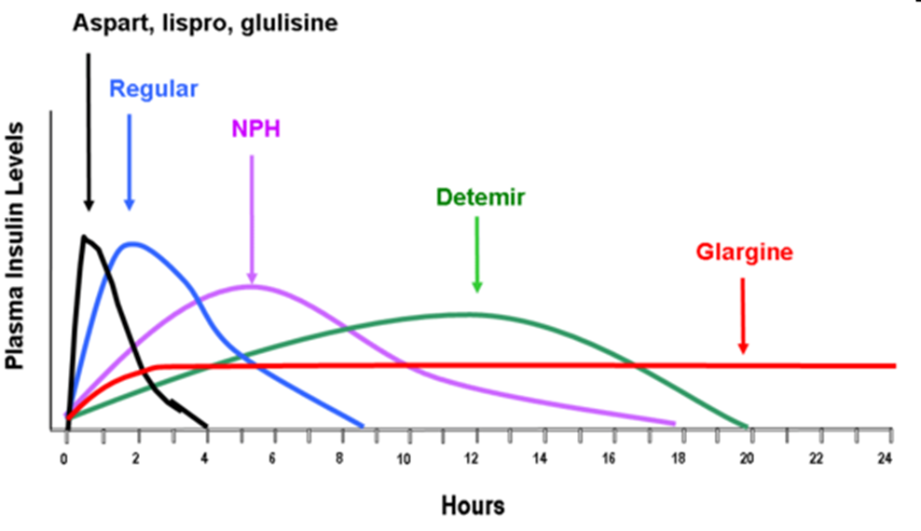
Pharmacokinetics

Slide 40
Insulin
Primary Mechanism of Action
Stimulate peripheral glucose uptake
Decrease hepatic glucose production (HGP)
Inhibits proteolysis, enhances protein synthesis, and inhibits lipolysis in adipocytes
Agent(s)
Short acting (Regular human insulin)
Rapid acting (Novolog, Humalog, Glulisine)
Intermediate acting: NPH
Long acting: Lantus and Levemir (can not be mixed with other insulins)
Mean drop in A1c
1.5-3% (most effective treatment for hyperglycemia)
Side effects:
Hypoglycemia, injection site reaction, rash, weight gain, peripheral edema
Nathan DM, Buse JB, Davidson MB, et al. Diabetes Care. 2009; 32(1): 193-203)

Slide 41
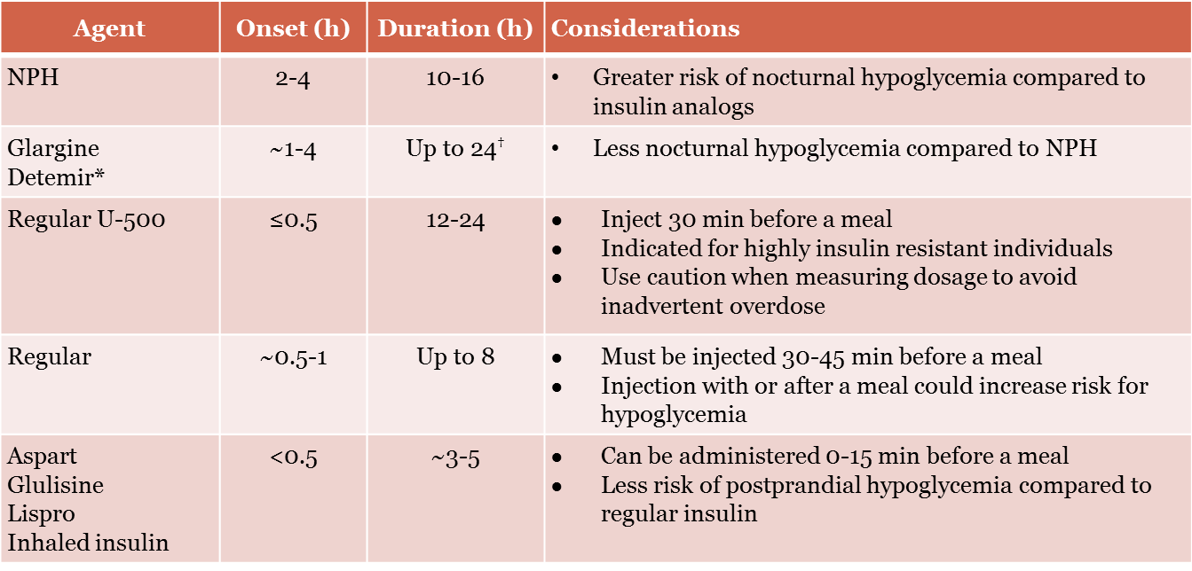
Insulin Medications

Slide 42
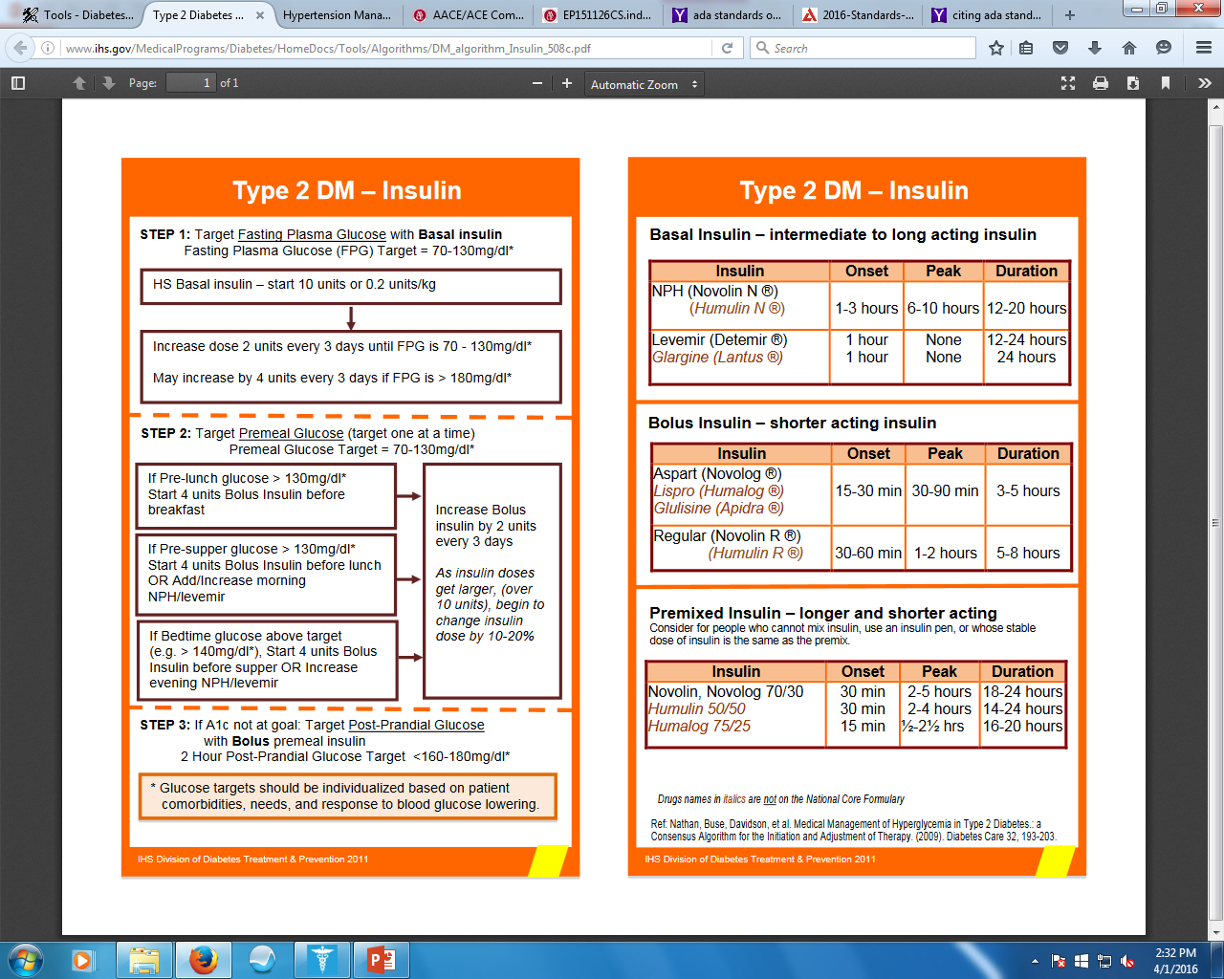

Slide 43
Starting Insulin
Starting Insulin
Basal 0.1-0.2 Units/kg/day or 10 units
Adjust 1-2/week by 10-15% or 2-4 units
Goal pre-prandial 80-130mg/dL
Adding Bolus Prandial Insulin
Start if FBG reached, but A1c not controlled or TDD >0.5 U/kg/day
Bolus 4 units or 0.1 U/kg or 10% of Basal dose with largest meal
Adjust 1-2/week by 1-2 U or 10-15%
Add additional “bolus” with >2 meals
Adding Premixed
Divide Basal dose: 2/3 in am and 1/3 in pm
Adjust 1-2/week by 1-2 U or 10-15%

Slide 44
Adjusting Insulin
Day | Insulin Dose | Blood Sugar
 |  | Breakfast | Lunch | Dinner | Bedtime
1 | Levemir 30 units hs | 114 | 179 | 128 | 119
2 | Levemir 30 units hs | 118 | 183 | 136 | 127
3 | Levemir 30 units hs | 110 | 159 | 125 | 123
FBG controlled – Lunch pre-prandial BS above goal
Start: Bolus Insulin with Breakfast
Dose: 4 units, 0.1 U/kg (weight 100kg = 10 units), 10% = 3 unit

Slide 45
Switching Between Insulin
Intermediate to Basal
Once daily – convert 1:1
Twice daily – Use 80% of dose
Converting to U500
Use 80% of TDD insulin dose, given 30 minutes before meals
TDD = 200-300 units/day divide dose bid
TDD = 300-750 units/day divide dose tid
TDD = 750-2000 units/day divide dose four times daily
TDD >2000units/day consider insulin pump

Slide 46
New Classes
Inhaled Insulin - Afrezza
Concentrated Insulin
U200
U300
Ultra Long-Acting Insulin
Biosimilars

Slide 47
Inhaled Insulin - Afrezza
Second Generation Inhaled Insulin
Approved June 2014
Ultra Rapid-acting inhaled insulin for adults at least 18 years of age with T1DM or T2DM.
Technosphere Insulin, dry powdered insulin for prandial coverage in non-smoking adults without pulmonary diseases
In patients with T1DM, Afrezza must be used in combination with long-acting insulin.

Slide 48
Inhaled Insulin – Afrezza
Administration
Give immediately prior to meal, reaches peak plasma in 12-15 minutes
Storage
Sealed foil packages refrigerated, once opened may be out of fridge for 10days
Inhaler must be replaced every 15 days
Safety
Risk of acute bronchospasm in patients with chronic lung disease
Contraindicated in patients with Asthma, COPD, lung cancer, current smokers or cessation smokers within last 6 months

Slide 49
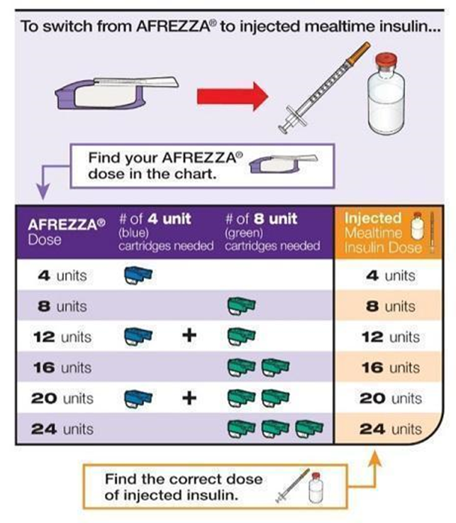
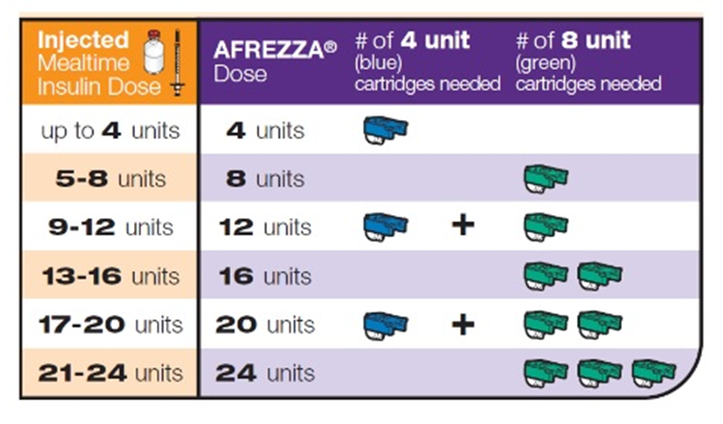
Inhaled Insulin – Afrezza
https://www.afrezzapro.com/dosing-conversions#close

Slide 50
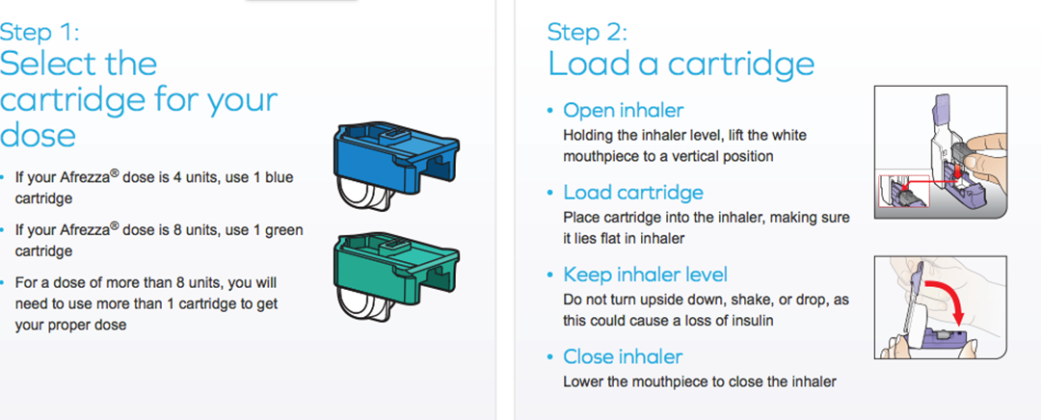
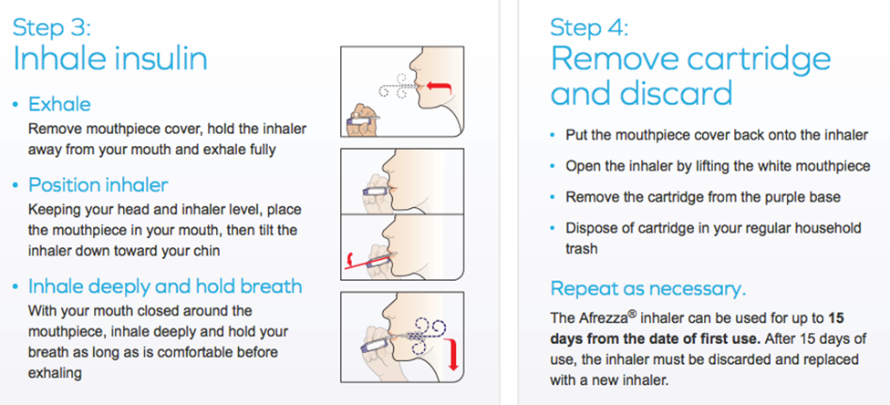
Inhaled Insulin - Afrezza
https://www.afrezza.com/step-by-step-guide

Slide 51
Inhaled Insulin – Afrezza
Advantages
Reduces number of insulin injections
Can be used immediately before meal
Disadvantages
Contraindicated in pts with respiratory problems, lung cancer or smokers
Multiple inhalations for higher insulin doses
Risk of lung function decreasing
Dosing increments of 4 and 8 units

Slide 52
Concentrated Insulin U-200
Humalog Kwikpen
Rapid acting mealtime insulin, identical to Humalog U100 except contains 200units/ml
Could be considered for people on >20 units/day of rapid acting insulin

Slide 53
Concentrated Insulin U-300
Toujeo (Insulin glargine)
Available in SoloStar pen, which only delivers up to 80 units per injection
Longer duration of action than Lantus (slower absorption)
Higher doses may be required to get same glycemic efficacy as Lantus
5 days to achieve maximum benefit, titrate every 3-4 days
Conversions:
Daily Lantus, Levemir or NPH 1:1 conversion
Twice daily Lantus 1:1, Levemir or NPH use 80% of total daily dose

Slide 54
Insulin Degludec
Approved September 2015
Ultra Long-acting insulin approved for adults at least 18 years of age with T1DM or T2DM.
Available in Flextouch pen U100 or U200 with dosing up to 160 units/injection
Tresiba [package insert]. Plainsboro, NJ: Novo Nordisk Inc; September 2015.

Slide 55
Insulin Degludec
Dosing and Administration
Once daily SQ dose, start at 10 units, 0.2-0.4mg/kg
Conversions:
Daily Lantus, Levemir or NPH 1:1 conversion
Pharmacokinetics
Half-life ~ 25 hours, Duration of Action ~42 hours
Storage
Unopened - Refrigerator
Opened – Unrefrigerated, stable for 8 weeks below 86°F
Safety
Similar rates of hypoglycemia to Insulin Glargine
Lower rates of nocturnal hypoglycemia compared to Insulin Glargine (not significant)
Tresiba [package insert]. Plainsboro, NJ: Novo Nordisk Inc; September 2015.

Slide 56
Biosimilars
Biosimilars are close to the original “reference” drug and produce similar therapeutic outcomes but are made differently and by different companies and will cost less than the original
First Insulin Biosimilars approved by FDA in 2014
Basaglar – similar to Lantus (under 30 month automatic stay due to patent infringement filed by Sanofi)
Abasria – European product

Slide 57
New DM Medications On the Horizon
Medication | Class | Dose | Expected Approval
Insulin peglispro | LA basal insulin | 5-10 units SQ daily | 2016
Lyxumia (lixisenatide) | GLP-1 agonist | 10mcg daily | 2015
Semaglutide | GLP-1 agonist | 0.8-1.6mg po weekly | 2016
Omariglipitin | DPP4 Inhibitor | 10-25mg po weekly | 2016
Tofogliflozin | SGLT2 | 10-40mg po daily | 2016
LY2409021 | Glucagon receptor antagonist | 5-200mg po daily | 2017

Slide 58
Patient Cases
75 yo female has T2DM, her HgA1c is 10.1 with SCr 0.9 and she is on Metformin 1000mg bid and glyburide 10mg . Select the best treatment plan.
Continue metformin, glyburide and add pioglitizone 15mg daily
Continue metformin, glyburide and add sitagliptin 5mg daily
Continue metformin, glyburide and add Levemir 10 units hs
Continue metformin, stop glyburide and add Levemir 10 units hs

Slide 59
Patient Cases
35 yo female with T2DM her HgA1c 9.1, BMI 44kg, BP 137/88, SCr 0.7. She is currently on Levemir 45 unit SQ bid, Novolog 10 units SQ AC, Lisinopril 20mg daily, omeprazole 20mg daily, metoclopramide 10mg TID, calcium/vit D. Intolerant to metformin. What would be the best option for her DM?
Add a DPP-IV inhibitor
Add a GLP1-agonist
Add SGLT-2 inhibitor
Adjust Insulin

Slide 60
Patient Cases
35 yo female with T2DM her HgA1c 9.1, BMI 44kg, BP 137/88, SCr 0.7. She is currently on Levemir 45 unit SQ bid, Novolog 10 units SQ AC, Lisinopril 20mg daily, omeprazole 20mg daily, metoclopramide 10mg TID, calcium/vit D. Her pooled cohort is 7%. What is the best option for the patient.
Add simvastatin 20mg HS
Wait until she is 40 then add statin
Add atorvastatin 20mg
Add atorvastatin 80mg

Slide 61
Patient Case
35 yo female with T2DM her HgA1c 9.1, BMI 44kg, BP 137/88, SCr 0.7. She is currently on Levemir 45 unit SQ bid, Novolog 10 units SQ AC, Lisinopril 20mg daily, omeprazole 20mg daily, metoclopramide 10mg TID, calcium/vit D. Intolerant to metformin. What else should be done to manage to optimize her therapy?
Add ASA EC 81mg
Add amlodipine 10mg daily
Increase Lisinopril to 30mg daily
Add Vitamin D3 1000units daily

Slide 62
Patient Cases
64 yo male on Levemir 50 units SQ HS and Novolog 15 units SQ AC. The chart displays his BS. How would you adjust his insulin?
Breakfast | Lunch | Dinner
101 | 180 | 150
99 | 220 | 135
104 | 207 | 141

Slide 63
Patient Case cont.
Change Levemir to 30 units SQ QAM and HS
Increase Novolog to 17 units SQ AC
Increase Novolog to 17 units qam, 15 units before lunch and dinner
Increase Novolog to 15 units qam and dinner and 17 units before lunch

Slide 64
Diabetes Complications

Slide 65
Hypoglycemia
Classification: Severe, Symptomatic, Asymptomatic, Probable, Pseudo-hypoglycemia
Risk Factors: Age, Insulin Excess, Type of Insulin, Impaired counter-regulatory response
Prevention: Goals, regimens, behavioral, hypoglycemia awareness
Treatment: Ingesting carbohydrates (15-20gm), glucagon 0.5-1mg SQ/IM, Dextrose 25gm IV, glucose infusion
ADA 2016 Clinical Practice Recommendations: http://care.diabetesjournals.org/content/39/Supplement_1

Slide 66
Diabetic Ketoacidosis and Hyperosmolar Hyperglycemic State
Findings and Treatment
Laboratory Values
Quick onset <24 hours
Symptoms: Nausea, vomiting, hyperventilation, abdominal pain, can progress to lethargy, focal deficits, obundation, seizure and coma
Causes: Infection, new onset DM, non-compliance, MI
Treatment: Fluids, Potassium, Insulin, maybe sodium bicarb
Lab | Severe DKA | HHS
Glucose | >250 | >600
Arterial pH | 7.25-7.3 | >7.3
Bicarb | 15-18 | >18
Urine/Serum ketones | Positive | Small
Serum osmolality 2(NA+glucose)/18 | Variable | >320
Anion gap Na-(Cl+HCO3) | >10 | Variable
Mental State | Alert | Stupor/Coma
ADA 2016 Clinical Practice Recommendations: http://care.diabetesjournals.org/content/39/Supplement_1

Slide 67
Cardiovascular Complications
Diabetes is a CHD risk equivalent!
ASCVD (ACS, MI, stable/unstable angina, stroke, TIA, PAD) is the leading cause of morbidity and mortality in diabetics
Risk factors: HTN, obesity, lipid abnormalities, smoking, family history of premature CAD, albuminuria
Assessment: Annually (at minimum)
Treatment: Multifactorial Cardiac risk reduction – smoking cessation, ASA therapy, hypertension control, statin, diet/exercise
ADA 2016 Clinical Practice Recommendations: http://care.diabetesjournals.org/content/39/Supplement_1

Slide 68
Hypertension
Prevent mortality, prevent CVD, prevent nephropathy and retinopathy
Goal Blood Pressure Targets
ADA: <140/90 mmHg
AACE: <130/80 mmHg
Treatment:
1st line – Ace Inhibitor or Angiotensin Receptor Blocker
2nd line – Calcium Channel Blocker, Thiazide Diuretic, Beta Blocker (carvedilol > metoprolol)*
3rd line – alpha blocker, central agents, vasodilators, aldosterone antagonist
ADA 2016 Clinical Practice Recommendations: http://care.diabetesjournals.org/content/39/Supplement_1
Notes:
ACEi and ARBs haven’t been proven to prevent albuminuria in pts without albuminuria
Thiazides may have adverse effect on glucose metabolism

Slide 69
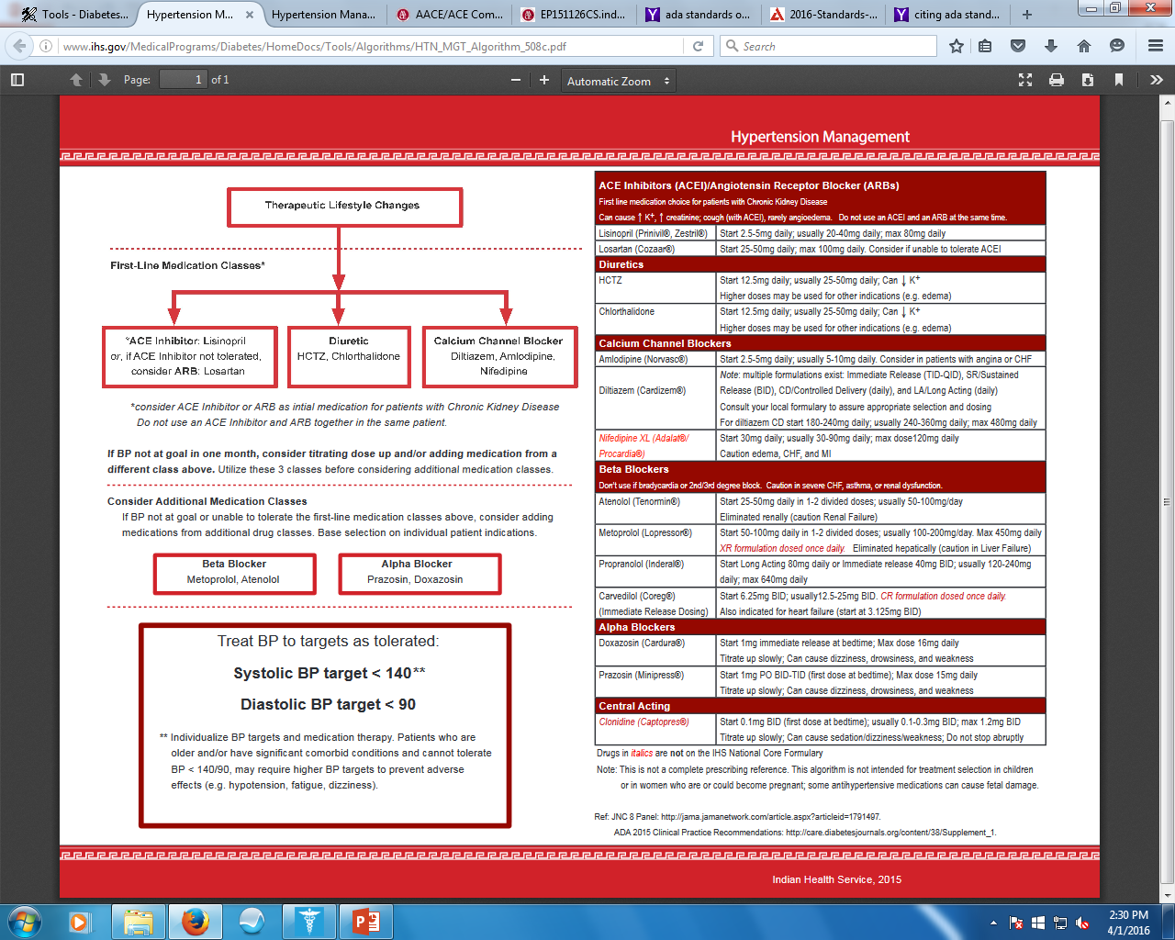

Slide 70
Hypertension Trials
Trial | Summary
UKPDS | Study Design: 148 T2DM, DB RCT Goal BP <150/85 or <180/105 with captopril or atenolol Results: Lower BP resulted in 24% reduction in DM endpoints (reduction in deaths, strokes and retinopathy and visual acuity)
ALLHAT | Study Design: 33,000 pts, RCT, mean BP 146/84 (36% had DM), randomized to chlorthalidone, amlodpine, lisinopril and doxazosin, primary outcomes (fatal CHD, or nonfatal MI) Results: No difference in primary outcome, significantly lower rate of new onset HF with chlorthalidone compared to amlodpine and lisinopril, and lower rate of combined CVD outcomes with chlorthalidone than lisinopril
ADVANCE | Study Design: Fixed combo perindopril-indapamide to placebo in 11000 pts with T2DM, mean BP 145/81. Primary endpoints (CVD death, nonfatal stroke or MI, proteinuria, doubling SCr, dialysis, death due to renal causes, retinopathy) Results: Significantly lower rate of Macrovascular and Microvascular events 15.5 vs 16.8%, CVD death and all-cause mortality

Slide 71
Hypertension Trials
Trial | Summary
ACCORD BP | Study Design: 4733 pts, T2DM who had CV disease or 2 risk factors of CVD randomized to intensive or standard therapy (goal SBP <120mmHg or <140mmHg) Results: Primary Endpoint (Non-fatal MI or stroke and CV death) not statistically different, Incidence of stroke was significantly reduced with intensive group. Intensive group achieved BP 119/64 mmHg on 3.4 medications and standard group achieved BP 143/70 mmHg on 2.1 medications
HOT | Study Design: ~19000 pts RCT, baseline BP 170/105, goal DBP <90, <85, <80mmHg. 3-00 DM Results: Relative risk of CV events was significantly reduced in the <80 mmHg compared to the <90mmHg (RR 0.49, 95%, CI 0.29-0.81)
SANDS | Study Design: 499 NA T2DM >40yo randomized to goal SBP <130mmHg and LDL <100mg/dL or SBP <115 mmHG and LDL <70mg/dL Results: No statistically significant difference in CV outcomes, more ADRs in aggressive group

Slide 72
Hypertension Medications
ACE Inhibitors, ARBs and CCB have little effect on glucose and A1c
Thiazide diuretics affect glucose metabolism and can cause hyperglycemia
Beta Blockers can mask hypoglycemic symptoms
Carvedilol may have less effect on glucose than metoprolol

Slide 73
Dyslipidemia
Insulin resistance, insulin deficiency and obesity are associated with
Hypertriglyceridemia
Low HDL
Normal to elevated LDL
Diabetes is associated with a high risk of vascular disease
CVD is the primary cause of death among people with type 1 and type 2 diabetes
Chronic hyperglycemia promotes the glycation of LDL-C, and both glycation and oxidation are believed to increase the atherogenicity of LDL-C
http://guidelines.diabetes.ca/browse/Chapter24, accessed March 30, 2016
ADA 2016 Clinical Practice Recommendations: http://care.diabetesjournals.org/content/39/Supplement_1

Slide 74
Dyslipidemia
ADA 2016 Treatment Recommendations – Follows AHA/ACC 2013 Guidelines
Age< 40 or T1DM
No risk factors – Moderate Intensity Statin
ASCVD risk factors – Moderate/High Intensity Statin
ASCVD – High Intensity Statin
Age > 40
No risk factors – Moderate Intensity Statin
ASCVD risk factors – High Intensity Statin
ASCVD – High Intensity Statin
Age >75
No risk factors – Moderate Intensity Statin
ASCVD risk factors – Moderate/High Intensity Statin
ASCVD – High Intensity Statin
ADA 2016 Clinical Practice Recommendations: http://care.diabetesjournals.org/content/39/Supplement_1

Slide 75
Dyslipidemia
Moderate Intensity ~ Lowers LDL by 30-50%
Atorvastatin 10-20mg
Rosuvastatin 2-10mg
Simvastatin 20-40mg
Pravastatin 40-80mg
Lovastatin 40mg
Fluvastatin XL 80mg
Pitavastatin 2-4mg
High Intensity ~ Lowers LDL by >50%
Atorvastatin 40-80m g
Rosuvastatin 20-40mg
Moderate intensity statin plus ezetimibe for those intolerant to high intensity
ADA 2016 Clinical Practice Recommendations: http://care.diabetesjournals.org/content/39/Supplement_1

Slide 76
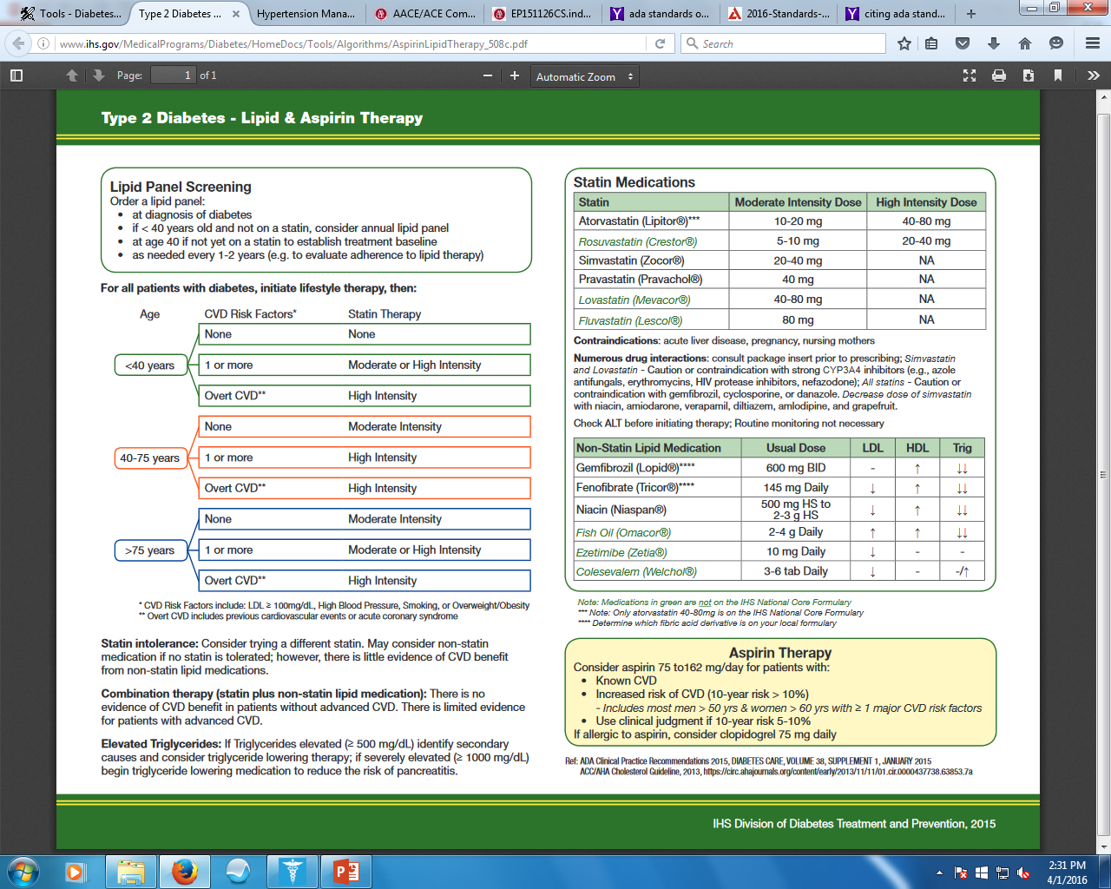

Slide 77
Dyslipidemia
Clinical Evidence
Fixed-dose statin therapy to reduce ASCVD risk
Supported by multiple RCTs
No evidence to support other popular strategies
Treat to target
Lower cholesterol is better
Risk based treatment approaches
ADA 2016 Clinical Practice Recommendations: http://care.diabetesjournals.org/content/39/Supplement_1

Slide 78
Antiplatelet
Primary Prevention
Aspirin 75-162mg daily
T1DM or T2DM
10yr risk >10%
>50 yo w/ risk factor (family hx, htn, smoking, dyslipidemia albuminuria)
Secondary Prevention
Aspirin 75-162mg daily in those with DM and ASCVD
Clopidogrel can be used in place of those with ASA allergy
Dual Therapy: Up to 1 yr after ACS
ADA 2016 Clinical Practice Recommendations: http://care.diabetesjournals.org/content/39/Supplement_1

Slide 79
Microvascular
Nephropathy
Retinopathy
Neuropathy
Diabetic Peripheral Neuropathy
Diabetic Foot Ulcers
Gastroparesis
ADA 2016 Clinical Practice Recommendations: http://care.diabetesjournals.org/content/39/Supplement_1

Slide 80
Nephropathy
Prevalence: Occurs in 20-40% of Diabetics – leading cause of ESRD
Assessment: Annually assess urinary albumin, SCr & potassium
Urinary albumin-to-creatinine ratio (UACR)
Normal <30 mg/g Cr
Albuminuria >30 mg/g Cr (not diagnostic; exercise, infection, fever, CHF, menstruation, hyperglycemia can falsely elevate)
Interventions
CKD – Dietary Protein intake 0.8g/kg
Intensive glucose management to slow progression
Lower BP goal appropriate <130/80 mmHg
ACEi or ARB
ADA 2016 Clinical Practice Recommendations: http://care.diabetesjournals.org/content/39/Supplement_1

Slide 81
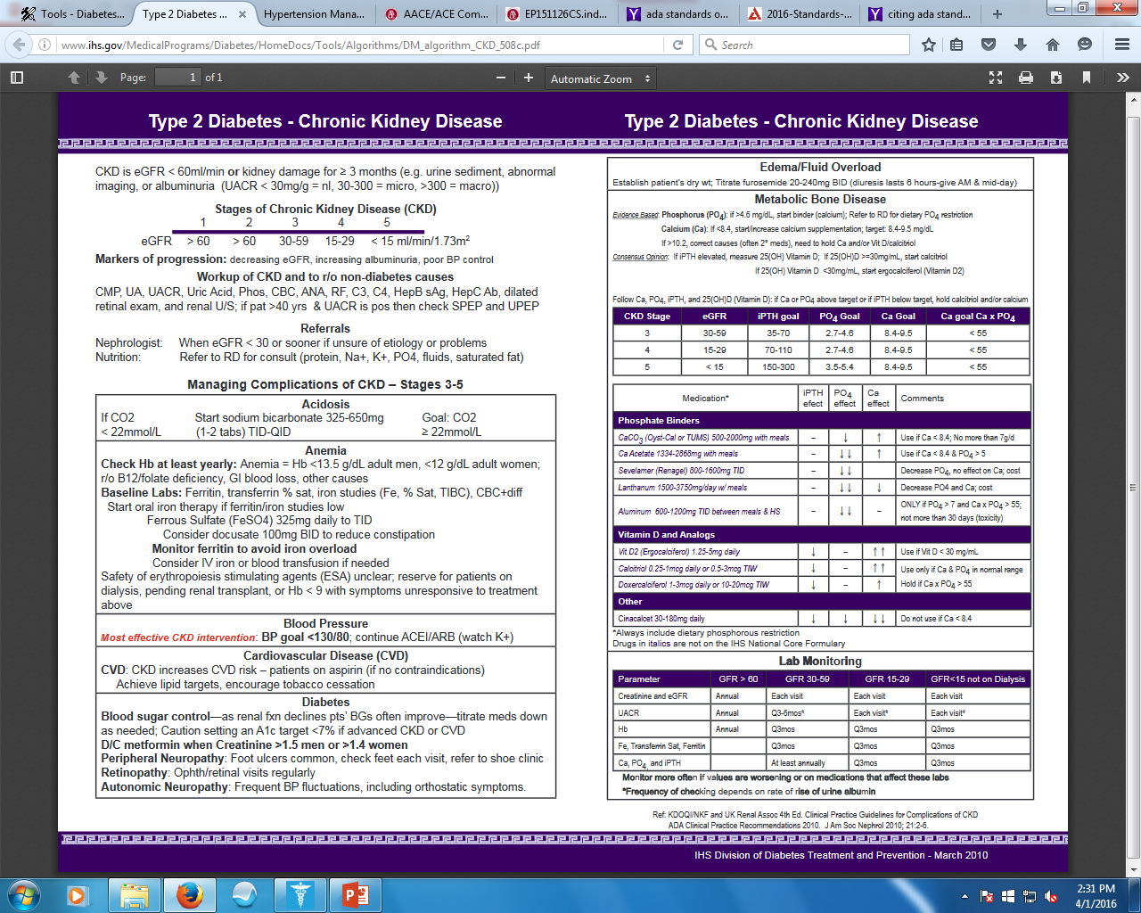

Slide 82
Retinopathy
Prevalence: Occurs in both Type 1 and Type 2, most common cause of blindness in adults 20-74 yo
Screening
Type 1 – baseline then in 5 years, annually or biannually thereafter
Type 2 – baseline then annually or biannually thereafter
Pregnancy – Pre-existing T1 or T2DM before pregnancy, each trimester then a year post-partum
Macular edema, severe non-proliferative diabetic retinopathy
ADA 2016 Clinical Practice Recommendations: http://care.diabetesjournals.org/content/39/Supplement_1

Slide 83
Retinopathy
Interventions
Managing Blood Glucose, Blood Pressure and Lipids
Laser photocoagulation therapy
Intravitreal injections
ADA 2016 Clinical Practice Recommendations: http://care.diabetesjournals.org/content/39/Supplement_1

Slide 84
Diabetic Peripheral Neuropathy
Prevalence: Up to 41% of Diabetics after 10 years of diagnosis
Initially affects lower distal extremities and ascends
Assessment
Annually for symptoms (burning, tingling, picky, numbness)
Annually for small/large fiber function: 10g monofiliament and one other (pinprick, temperature sensation, vibration perception)
Use of Screening tool for diagnosis and staging is helpful
ADA 2016 Clinical Practice Recommendations: http://care.diabetesjournals.org/content/39/Supplement_1

Slide 85
Diabetic Peripheral Neuropathy
Treatment
Optimize glucose control
Pain Treatment
FDA approved pharmacologic treatment: duloxetine, pregabalin, tapentadol
Non FDA approved treatment: TCAs, gabapentin, venlafaxine, carbamazepine, tramadol, topical capsaicin
Foot Care
ADA 2016 Clinical Practice Recommendations: http://care.diabetesjournals.org/content/39/Supplement_1

Slide 86
Diabetic Peripheral Neuropathy
American Academy of Neurology 2011 Guideline
Effective: Pregabalin 300-600mg daily
Probably Effective: Gabapentin, valproate, amitriptyline, duloxetine, venlafaxine, dextromethorphan, morphine, oxycodone, tramadol, capsaicin, isosorbide dinitrate
Possibly Effective: Lidocaine patch
Probably Not Effective: Oxcarbazepine, lamotrigine, lacosamide, clonidine, pentoxifylline, mexiletine
Evidence-based guideline: Treatment of painful diabetic neuropathy: report of the American Academy of Neurology, the American Association of Neuromuscular and Electrodiagnostic Medicine and the American Academy of Physical Medicine and Rehabilitation

Slide 87
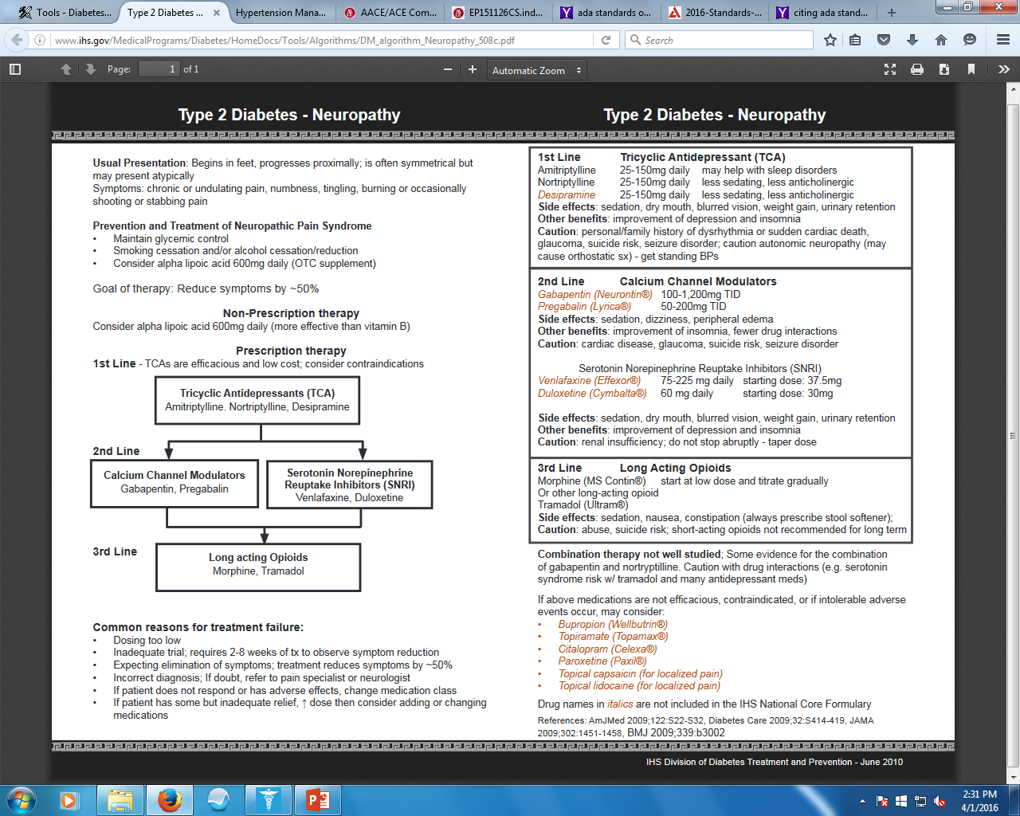

Slide 88
Diabetic Foot Care
Screening:
Annually inspect skin, foot deformities, DPN assessment, vascular (pulses in legs and feet)
Loss of Protective Sensation (LOPS)
Peripheral Arterial Disease
Risk of Ulcers and Amputations:
History of foot ulcer, amputation, foot deformities, skin dryness DPN w/LOPS, pre-ulcerative callus or corn, PAD, poor glycemic control, visual impairment, cigarette smoking
Prevention
Patient Education: appropriate foot wear, daily foot inspections, nail/skin care, clean/breathable socks
ADA 2016 Clinical Practice Recommendations: http://care.diabetesjournals.org/content/39/Supplement_1

Slide 89
Diabetic Foot Ulcers
Prevalence:
Ulcers - Up to 25% lifetime risk
25% of Diabetic admissions are for infected or ischemic diabetic foot ulcers
Amputation - ~5% of Diabetics will require amputation of toe/foot
Grading and Staging
Grades 0, 1, 2, 3
Stage A, B, C, D
Treatment
Debridement and wound care
Mechanical off-loading
Antibiotic treatment
Revascularization
ADA 2016 Clinical Practice Recommendations: http://care.diabetesjournals.org/content/39/Supplement_1

Slide 90
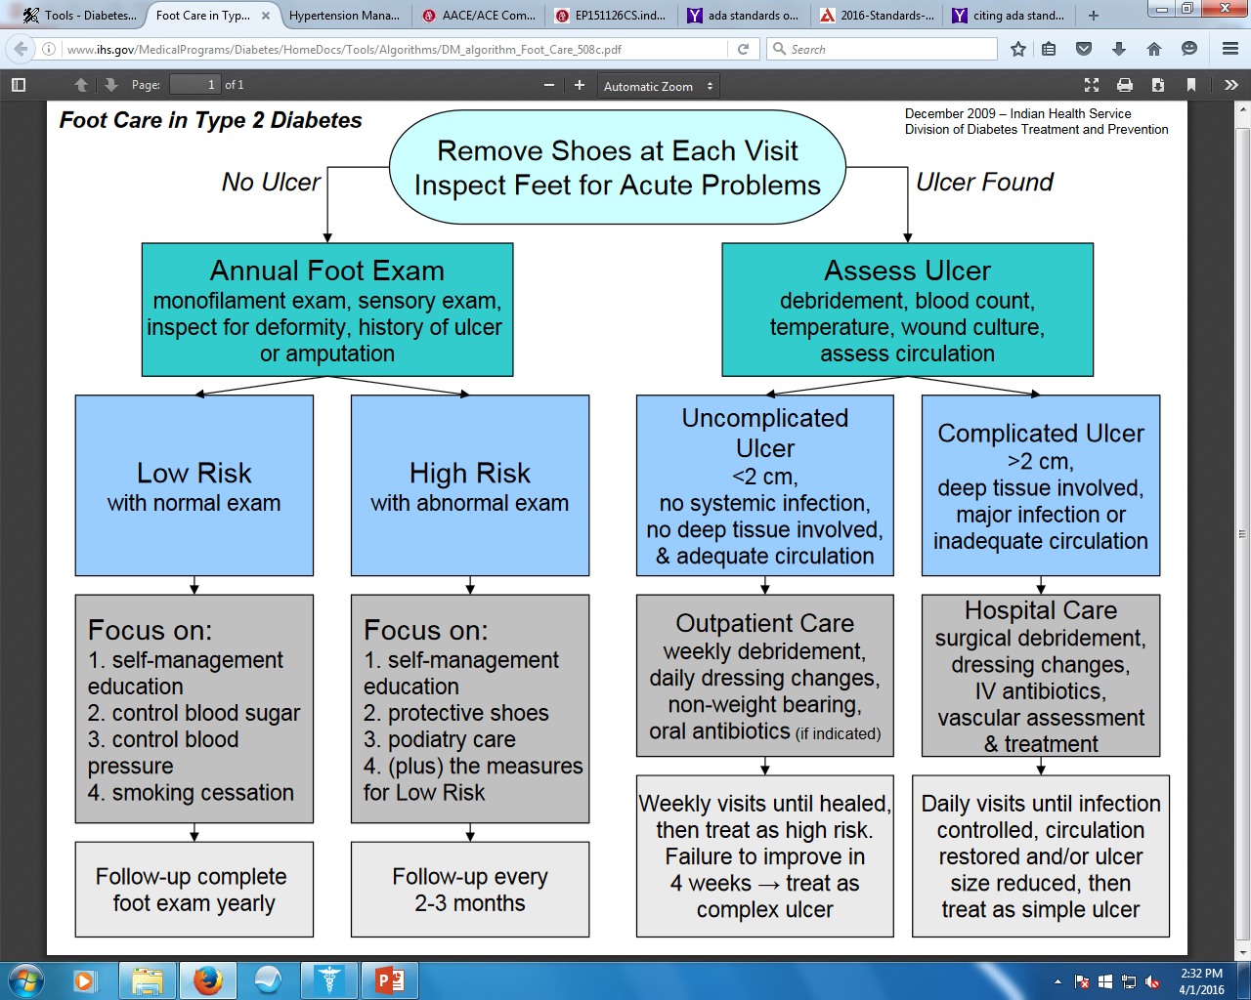

Slide 91
Gastroparesis
Delayed gastric emptying
Symptoms
Nausea, Vomiting, early satiety, bloating, abdominal pain
Treatment
Dietary Modification
More: Small/frequent meals low in fat and fiber, hydration
Less: fatty, acidic, spicy, roughage food, carbonated, smoking, alcohol
Glucose control
Prokinetic Medications
Metoclopramide 5-10mg AC and HS up to 12 weeks
Erythromycin 40-250mg AC up to 4 weeks
ADA 2016 Clinical Practice Recommendations: http://care.diabetesjournals.org/content/39/Supplement_1

Slide 92
Conclusions
Metformin is still the first-line medication treatment option for T2DM.
GLP-1 agonists may be an alternative for patient’s who doesn’t tolerate metformin as first-line.
Choosing second or third line DM medications must depend on patient preference, patient’s medical history and cost.
Several new medications are on the horizon but no new novel mechanisms.

Slide 93
Conclusions
Preventing and treating macrovascular and microvascular complications are vital in reducing mortality and morbidity
Blood Pressure goals for Diabetics are <140/90mmHG
All diabetics should be on statin therapy if tolerated and maximized to moderate or high intensity depending on their ASCVD risk

Slide 94
References
ADA 2016 Clinical Practice Recommendations: http://care.diabetesjournals.org/content/39/Supplement_1
Management of hyperglycemia in type 2 diabetes, 2016: a patient-centered approach: update to a position statement of the American Diabetes Association and the European Association for the Study of Diabetes. Diabetes Care. 2016
AACE/ACE Comprehensive Type 2 Diabetes Management Algorithm 2016 Published in Endocr Pract.2016;22:84-113
Micromedex® Solutions [online]. Updated periodically. Truven Health Analytics, Inc. Accessed July 30, 2015.
Insulin. Facts and Comparisons® eAnswers. Drug Facts and Comparisons® [online]. Updated periodically. Clinical Drug Information, LLC. Accessed July 30, 2015.
Hajheydari Z, Kashi Z, Akha O, Akbarzadeh S. Frequency of lipodystrophy induced by recombinant human insulin. European Review for Medical and Pharmacological Sciences. 2011; 15(10): 1196-1201.
Toujeo®, insulin glargine injection 300 Units/mL [package insert]. Sanofi-Aventis, LLC. Bridgewater, NJ. 2015.
Afrezza®, human insulin inhalation powder [package insert]. Sanofi-Aventis, LLC. Bridgewater, NJ. 2015.

Slide 95
References
Farxiga (dapagliflozin) [prescribing information]. Princeton, NJ: Bristol-Myers Squibb Company;
Jardiance (empagliflozin) [prescribing information]. Ridgefield, CT: Boehringer Ingelheim Pharmaceuticals, Inc;
American Diabetes Association (ADA). Standards of medical care in diabetes--2015. Diabetes Care. 2015;38(Suppl 1):S1-94.
FDA Safety Communication. FDA warns that SGLT2 inhibitors for diabetes may result in a serious condition of too much acid in the blood. Food and Drug Administration website. http://www.fda.gov/Drugs/DrugSafety/ucm446845.htm.
Invokana (canagliflozin) [prescribing information]. Titusville, NJ: Janssen Pharmaceuticals, Inc;
http://documents.byetta.com/Byetta_PI.pdf
http://www1.astrazeneca-us.com/pi/pi_bydureon.pdf#page=1
2013 ACC/AHA Guideline on the Treatment of Blood Cholesterol to Reduce Atherosclerotic Cardiovascular Risk in Adults: A Report of the American College of Cardiology/American Heart Association Task Force on Practice Guidelines. Circulation, 2013 Nov 12. With Full Report Supplement.
Rising tide of cardiovascular disease in American Indians: the Strong Heart Study Howard BV, Lee ET, Cowan LD, Devereux RB, Galloway JM, Howard WJ, Rhoades ER, Robbins DC, Sievers ML, Welty TK. Circulation. 1999;99:2389 –2395.
Racial Misclassification and Disparities in Cardiovascular Disease Among American Indians and Alaska Natives Dorothy A. Rhoades. Circulation. 2005;111:1250-1256.

Slide 96
Questions

